Slide 1

Benefits of Competition
A Primary Feature of a Free Market Economy
Copyright Stock-Trak, Inc. 2023-2024

Slide 2
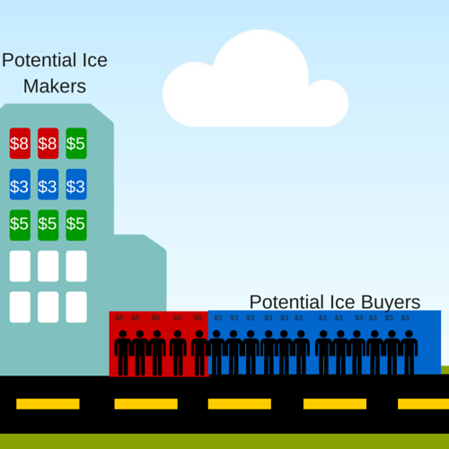
Competition is…
The act of producers competing to sell similar goods to the same set of consumers.
For example: low-cost vs luxury ice producers
Notes:
Ice Seller Market: some of the sellers used their profits to invest in new higher-capacity and energy-efficiency freezers that make it cheaper and easier for them to produce the same ice. Allowing them to compete on price.
At the same time, some of the other sellers used their profits to research methods to make luxury ice, like ice spheres and crystal-clear large cubes, which they can then sell at a higher price.

Slide 3





Main Features of Competition
Multiple Sellers - multiple businesses selling similar products or services to the same group of consumers.
Price Variation – as businesses compete to attract more customers.
Product Innovation – constant improvements to outperform competitors.
Consumer Choice – for more niche tastes, preferences or needs.
For example: athletic footwear market
Notes:
Multiple Sellers: There are multiple businesses selling similar products or services to the same group of consumers.
Price Variation: There is a variance in prices as businesses compete to attract more customers.
Product Innovation: There is constant innovation and improvement of products to outperform competitors.
Consumer Choice: Competition means consumers have multiple options and can choose the product that best meets their needs.

Slide 4

Profit Motive
Profit Motive is a key driving force in free market economies.
Unchecked profit motive can have negative effects on consumer well-being and the environment.
Businesses may:
Compromise on safety measures and produce substandard or unsafe products.
Fail to consider or internalize the social and environmental costs associated with business activities.
Notes:
In the United States, several laws and acts are in place to protect consumer rights and ensure environmental protection. Here are some of the main acts in each category:
Consumer Protection Acts:
1. Federal Trade Commission Act (FTC Act)
2. Fair Credit Reporting Act (FCRA)
3. Fair Debt Collection Practices Act (FDCPA)
4. Truth in Lending Act (TILA)
5. Consumer Credit Protection Act (CCPA)
6. Consumer Product Safety Act (CPSA)
7. Magnuson-Moss Warranty Act
8. Electronic Fund Transfer Act (EFTA)
9. Telephone Consumer Protection Act (TCPA)
10. Food, Drug, and Cosmetic Act (FD&C Act)
Environmental Protection Acts:
1. Clean Air Act (CAA)
2. Clean Water Act (CWA)
3. Comprehensive Environmental Response, Compensation, and Liability Act (CERCLA) or Superfund Act
4. Resource Conservation and Recovery Act (RCRA)
5. Endangered Species Act (ESA)
6. National Environmental Policy Act (NEPA)
7. Toxic Substances Control Act (TSCA)
8. Safe Drinking Water Act (SDWA)
9. Oil Pollution Act (OPA)
10. Federal Insecticide, Fungicide, and Rodenticide Act (FIFRA)
Image Reference: FTC Collaboration Act of 2021 Study | Federal Trade Commission

Slide 5

Externalities
Externalities refer to the costs or benefits that arise from the production or consumption of goods or services but are not reflected in the market prices.
For Example: traffic congestion, pollution, or knowledge sharing.
Notes:
In other words, externalities are the positive or negative consequences that affect third parties or society as a whole, without being accounted for in the transaction between the buyer and seller.
Externalities highlight how market transactions may have social and environmental impacts that go beyond the immediate buyers and sellers, and they often require government intervention or regulation to address them effectively.
Positive Externalities:
- Research and development: Investments in research and development can benefit society by spurring innovation and technological advancements that have widespread positive effects.
- Education: When individuals receive education, it benefits not only themselves but also society as a whole by improving productivity, reducing crime rates, and fostering economic growth.
Negative Externalities:
- Environmental pollution: Industries that emit pollutants like air or water pollution impose costs on society, including health impacts, ecological damage, and reduced quality of life.
- Traffic congestion: Increased road traffic leads to delays, wasted time, and increased fuel consumption, affecting not only individual travelers but also the productivity and well-being of the community.
- Secondhand smoking: The negative health effects of secondhand smoke impact not only smokers but also non-smokers who are exposed to the toxins, leading to increased healthcare costs and risks to public health.
Image Reference: Pollution board identifies industries causing harm to environment - The Statesman

Slide 6
Role in a Market Economy
The principle of competition underpins the functioning of a market economy.
The desire for higher profits fosters competition among businesses, seeking to offer better products or services.
To maximize profits, businesses strive for increased operational efficiency, eliminating wastage and optimizing resource utilization.
The unchecked profit motive can also lead to negative outcomes, such as unfair business practices or environmental damage; thus, regulation is necessary.
Notes:
The principle of competition underpins the functioning of a market economy.
The desire for higher profits fosters competition among businesses, seeking to offer better products or services.
To maximize profits, businesses strive for increased operational efficiency, eliminating wastage and optimizing resource utilization.
The unchecked profit motive can also lead to negative outcomes, such as unfair business practices or environmental damage; thus, regulation is necessary.

Slide 7
Pros and Cons of Competition
Pros
Cons
Lower Prices
Improved Quality
Increased Consumer Options
Innovation
Efficiency
Market Monopolization
Unethical Business Practices
Oversaturation
Short-Term Focus
Inequality
Notes:
Pros of Competition:
Lower Prices: Competing businesses may lower their prices to attract more customers.
Improved Quality: Companies often enhance the quality of their products to gain a competitive edge.
Increased Consumer Options: Competition results in a wider product or service range, offering more choices for consumers.
Innovation: Businesses are forced to innovate to stand out in a competitive marketplace.
Efficiency: To outperform rivals, businesses need to operate more efficiently, which often leads to cost savings that can be passed onto the consumers.
Cons of Competition:
Market Monopolization: Some companies may become so successful that they dominate the market, leading to a decline in competition.
Unethical Business Practices: To outdo competitors, some businesses may resort to unfair or unethical practices.
Oversaturation: Too many competitors might create an oversaturated market, making it hard for businesses to survive.
Short-term Focus: Competition can often make businesses focus on short-term gains at the expense of long-term strategies.
Inequality: Successful businesses can grow exponentially, leading to income and wealth disparities.

Slide 8

Influencing Factors
Barriers to Entry: cost of equipment, specialized knowledge or skills.
Access to Capital: raise or access enough money for operations.
Regulatory Requirements: licenses, permits, and compliance with regulations & policies.
Market Saturation - the number of existing competitors in the market.
Technology & Innovation - the ability to innovate and integrate technology.
Notes:
The ability for a new business to enter a market and successful compete is contingent on several factors:
Barriers to Entry: High entry barriers, such as significant startup costs, can prevent potential businesses from entering the market. These can include the cost of equipment, regulations, or the need for specialized knowledge or skills.
Access to Capital: Companies' ability to raise or access enough investment capital to start and maintain operations can hugely influence the degree of competitiveness in a particular market. Those with more capital have greater capacity to innovate, market their products, and hence compete.
Regulatory Requirements: The need for licenses, permits, and compliance with safety, environmental, and other regulations can influence competition by making it more challenging for new players to enter the market.
Market Saturation: The number of existing competitors in the market can deter new entrants. In well-saturated markets, it's difficult for new businesses to establish a customer base and succeed.
Technology and Innovation: The ability of a company to innovate and integrate technology into its operations or offerings can give it a competitive advantage over others in the same market, thereby influencing competition.
Image Reference: https://www.freepik.com/free-photo/experienced-operator-hard-hat_10519397.htm

Slide 9
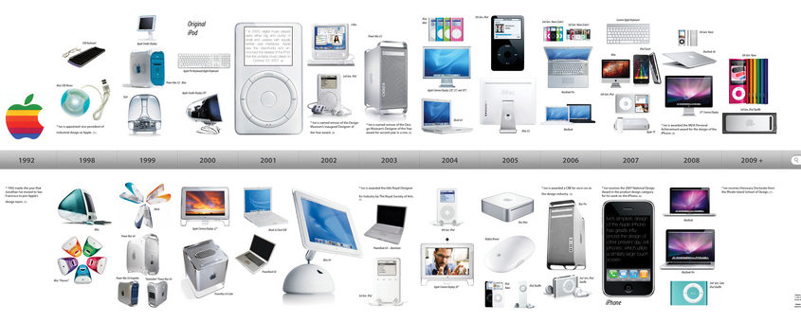
Role of Innovation
Differentiation
Attract Customers
Increase Efficiency
Market Leadership
Creates New Markets
Notes:
Differentiation - allowing product or service differentiation to stand out in a competitive market.
Attract Customers - helps businesses to attract and retain customers by offering something new and unique.
Increase Efficiency - allowing businesses to reduce costs and remain competitive on prices.
Market Leadership – can position themselves as leaders in their market
Creates New Markets – giving first-mover advantage while stimulating further competition in the new area.
Examples of companies that are often recognized for their innovation:
1. Apple Inc.: Apple has consistently been regarded as an innovative company, known for its groundbreaking products like the iPhone, iPad, and Mac. Its design-focused approach, user-friendly interfaces, and seamless integration of hardware, software, and services have set industry standards and disrupted multiple markets.
Image Reference: What to buy, a Mac or PC? - IT Experts
2. Amazon.com Inc.: Amazon is widely known for its disruptive innovations in e-commerce and cloud computing with Amazon Web Services (AWS). It has revolutionized online shopping, introduced services like Prime delivery, and constantly expanded its product and service offerings, including smart home devices (Amazon Echo) and streaming services (Amazon Prime Video).
3. Tesla Inc.: Tesla is at the forefront of the electric vehicle (EV) revolution, pushing the boundaries of automotive technology. It has brought EVs into the mainstream with its innovative electric cars, advanced battery technologies, and autonomous driving features. Tesla's impact on the automotive industry and its visionary approach to sustainable transportation make it a recognized innovator.

Slide 10
Information & Marketing
Lack of consumer information can distort competition, as consumers must research multiple alternatives to find the best offers.
Marketing ensures that consumers are aware of a business's products and perceive it as superior to competitive products.
  Marketing shapes how consumers perceive a brand - its values, quality, and reputation, which can influence customer loyalty and purchasing decisions.
Notes:
Marketing ensures that consumers are aware of a business's product and perceive it as superior to competitive products.
Awareness: Marketing campaigns raise consumer awareness about a product or service, informing potential customers that a product exists and how it can benefit them.
Product Understanding: Through marketing, companies educate consumers about the features and functions of their products or services, helping them understand how it meets their needs or solves a problem.
Purchase Decisions: The information provided through marketing influences consumer decisions on what to buy, where to buy, and at what price.
Promotions and Discounts: Marketing often includes information about sales, promotions, or discounts, allowing customers to take advantage of lower prices.
Brand Perception: Marketing shapes how consumers perceive a brand - its values, quality, and reputation, which can influence customer loyalty and purchase decisions.
Comparison: By providing product information, marketing allows consumers to compare different offerings in the market and choose the one that fits their needs and budget the best.

Slide 11

Cartels
A Cartel is group of independent companies coordinating their production, pricing, and other policies to control competition and increase profits.
For Example:
The Organization of the Petroleum Exporting Countries (OPEC) maintaining strong oil prices to benefit member countries by controlling output.
Notes:
Can lead to higher prices, decreased product quality, and limited market entry for potential competitors.
Government regulations and antitrust laws intend to prevent these (official or unofficial) agreements from forming.
Image Reference: 02072021-1.jpg (1920×1080) (meritkapital.com)

Slide 12
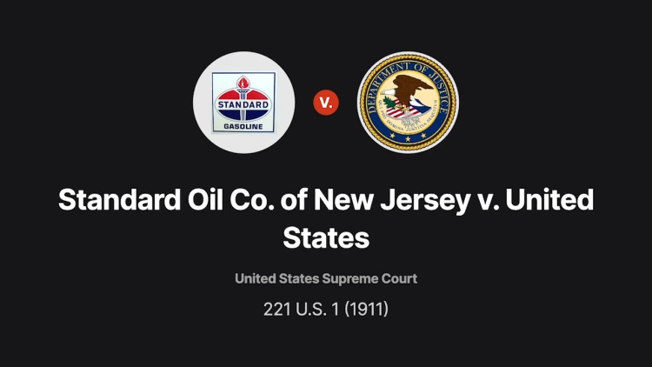
Monopolies
A Monopoly is when a market is entirely served by a single producer, while competition is either barred completely or impractical to establish. Government regulation prevents them from forming.
For Example: Landmark antitrust case Standard Oil Co. of New Jersey v. United States
Notes:
For Example: The case of the Standard Oil Company, led by John D. Rockefeller. Standard Oil, founded in 1870, eventually emerged as a dominant force in the oil industry, controlling the majority of oil production, refining, distribution, and marketing in the country.
By employing aggressive business tactics, such as predatory pricing, acquiring rival companies, and securing exclusive deals with railroads, Standard Oil gained significant market power and influence. It achieved such dominance that, at its peak, it controlled around 90% of the oil refining industry in the United States.
Standard Oil's monopoly status led to concerns about unfair competition, reduced consumer choice, and higher prices.
In 1911, a landmark antitrust case, known as the Standard Oil Co. of New Jersey v. United States, resulted in the Supreme Court ordering the dissolution of Standard Oil into multiple smaller companies, known as the "Baby Standards."
This case and subsequent legislation, such as the Sherman Antitrust Act of 1890, were significant in establishing the legal framework to prevent and regulate monopolistic practices, ensuring fair competition in the marketplace and protecting consumer interests.
Reference: Standard Oil Co. of New Jersey v. United States :: 221 U.S. 1 (1911) :: Justia US Supreme Court Center
Image Reference: Standard Oil Co. of New Jersey v. United States, 221 U.S. 1 (1911): Case Brief Summary | Quimbee

Slide 13
Beneficial Monopolies
Beneficial Monopolies happen when the government gives a business the exclusive right to provide a product or service.
For Example: water, electricity, mining or logging companies.
The government sets a maximum profit margin that a monopoly is allowed to earn.
Notes:
The maximum profit margin allows the business to attract investors to the project, but not gouge prices for the customer.

Slide 14
Barriers to Competition
Real Barriers
Artificial Barriers
High Initial Investment
Scale of Activity
Access to Distribution Channels
Brand Loyalty
Proprietary Technology
Skilled Labour
Legal and Regulatory Restrictions
Unfair Trade Practices
Exclusive Contracts
Intellectual Property Restrictions
Trade Tariffs and Quotas
Notes:
Real Barriers to Competition:
High Initial Investment: The need for large capital to start up can deter potential competitors.
Economic Scale: Established companies having economies of scale can produce goods at a lower cost, discouraging new entrants.
Access to Distribution Channels: New companies might face challenges in persuading distributors to carry their products.
Brand Loyalty: Consumers' strong brand preferences can make it difficult for new entrants to gain market share.
Proprietary Technology: A company might have patented its technology, creating a barrier for others to enter the market.
Skilled Labor: A lack of access to skilled labor or specialized talents can create a real barrier.
Artificial Barriers to Competition:
Legal and Regulatory Restrictions: Requirements of licenses or permits to operate can create barriers for new entrants.
Unfair Trade Practices: Existing companies might use predatory pricing or other unfair practices to thwart new competitors.
Exclusive Contracts: Some businesses might have exclusive agreements with suppliers or distributors, blocking new businesses.
Intellectual Property Restrictions: Patents, copyrights, and trademarks can make it difficult for new ventures to compete.
Trade Tariffs and Quotas: Government policies, such as high import tariffs or quotas, can discourage competitors from entering the market.

Slide 15
Discussion Questions
How does competition benefit consumers?
Can you think of any examples where competition has led to improvements in products or services?
Notes:
How competition benefits consumers:
Lower Prices: Competing businesses may lower their prices to attract more customers.
Improved Quality: Companies often enhance the quality of their products to gain a competitive edge.
Increased Consumer Options: Competition results in a wider product or service range, offering more choices for consumers.
Innovation: Businesses are forced to innovate to stand out in a competitive marketplace.
Efficiency: To outperform rivals, businesses need to operate more efficiently, which often leads to cost savings that can be passed onto the consumers.
Examples:
1. Smartphones: The intense competition between companies like Apple, Samsung, Google, and others has driven continuous innovation in the smartphone industry. This competition has resulted in advancements in features such as camera technology, display quality, processing power, battery life, and overall user experience.
2. Streaming Services: The rise of various streaming platforms, including Netflix, Amazon Prime Video, Disney+, and Hulu, has sparked a competitive landscape in the entertainment industry. This competition has led to the development of original content, improved streaming technology, personalized recommendations, and competitive pricing plans, ultimately benefiting consumers with a wider range of entertainment options and improved user experience.
3. Ride-Sharing Services: The emergence of ride-sharing companies like Uber and Lyft has transformed the transportation industry. The competition among these platforms has led to improved convenience, lower prices, enhanced safety features, and technological advancements like real-time tracking, cashless transactions, and driver ratings, which significantly benefit consumers.
4. Airline Industry: The competition among airlines has resulted in improved services for passengers. Airlines continuously strive to offer better amenities, in-flight entertainment, more comfortable seating options, enhanced loyalty programs, and improved punctuality and customer service to attract and retain customers.
5. E-commerce: The rise of online shopping platforms like Amazon, eBay, and Alibaba has revolutionized the retail industry. Competition in this space has led to improved customer experiences, faster delivery, expanded product selections, competitive pricing, and innovative technologies like personalized recommendations, customer reviews, and hassle-free returns.
6. Food and Beverage Industry: The competitive nature of the food and beverage industry has driven improvements in product quality, taste, and variety. Fast-food chains, for example, constantly innovate their menus, introduce new flavors, and offer competitive pricing to attract customers. Additionally, competition has led to a growing focus on healthier food options, dietary accommodations, and sustainability practices.

Slide 16
Discussion Questions
Discuss the role of barriers to entry in limiting competition.
Can you identify any industries or markets where artificial barriers have hindered new producers from entering and competing?
Notes:
Real Barriers to Competition:
High Initial Investment: The need for large capital to start up can deter potential competitors.
Economic Scale: Established companies having economies of scale can produce goods at a lower cost, discouraging new entrants.
Access to Distribution Channels: New companies might face challenges in persuading distributors to carry their products.
Brand Loyalty: Consumers' strong brand preferences can make it difficult for new entrants to gain market share.
Proprietary Technology: A company might have patented its technology, creating a barrier for others to enter the market.
Skilled Labor: A lack of access to skilled labor or specialized talents can create a real barrier.
Artificial Barriers to Competition:
Legal and Regulatory Restrictions: Requirements of licenses or permits to operate can create barriers for new entrants.
Unfair Trade Practices: Existing companies might use predatory pricing or other unfair practices to thwart new competitors.
Exclusive Contracts: Some businesses might have exclusive agreements with suppliers or distributors, blocking new businesses.
Intellectual Property Restrictions: Patents, copyrights, and trademarks can make it difficult for new ventures to compete.
Trade Tariffs and Quotas: Government policies, such as high import tariffs or quotas, can discourage competitors from entering the market.
Examples of markets or industries:
Professional Services: Industries such as law, accounting, and consulting often have barriers to entry due to professional licensing requirements and the need for specialized knowledge. These barriers can make it challenging for new firms to establish themselves and compete with well-established and reputable firms.
Financial Services: The financial services industry faces barriers due to regulatory requirements and the high cost of compliance. Banks and other financial institutions must meet stringent regulatory standards to operate, making it difficult for new players to enter the market and compete with established institutions.
Pharmaceuticals and Biotechnology: The pharmaceutical industry faces barriers due to stringent regulatory processes and intellectual property restrictions. Obtaining drug approvals, complying with safety regulations, and navigating the patent landscape can be costly and time-consuming, making it difficult for new entrants to compete with established pharmaceutical companies.
Energy and Utilities: The energy and utilities sector often faces barriers due to heavy regulation and the high cost of infrastructure development. Government regulations and exclusive contracts with distribution networks can create hurdles for new competitors looking to enter the market and challenge incumbents.

Slide 17
Discussion Questions
What is the impact of information barriers on consumer choices and market competition?
How can marketing and advertising contribute to overcoming these barriers and influencing consumer decisions?
Notes:
Marketing ensures that consumers are aware of a business's product and perceive it as superior to competitive products.
Awareness: Marketing campaigns raise consumer awareness about a product or service, informing potential customers that a product exists and how it can benefit them.
Product Understanding: Through marketing, companies educate consumers about the features and functions of their products or services, helping them understand how it meets their needs or solves a problem.
Purchase Decisions: The information provided through marketing influences consumer decisions on what to buy, where to buy, and at what price.
Promotions and Discounts: Marketing often includes information about sales, promotions, or discounts, allowing customers to take advantage of lower prices.
Brand Perception: Marketing shapes how consumers perceive a brand - its values, quality, and reputation, which can influence customer loyalty and purchase decisions.
Comparison: By providing product information, marketing allows consumers to compare different offerings in the market and choose the one that fits their needs and budget the best.

Slide 18
Key Takeaways
Product innovation and differentiation are a result of competition, leading to a greater range of products and prices for consumers.
Barriers of entry can prevent new producers from entering the market and selling a competitive good.
Artificial barriers, such as licensing requirements and permits, can increase market prices and limit competition.
Cartels involve independent producers agreeing not to directly compete, which can raise market prices.
Monopolies occur when a market is served by a single producer, leading to higher prices and less innovation.
Beneficial monopolies, authorized by the government, can provide better prices and quality in certain circumstances, such as public utilities.
Notes:
Product innovation and differentiation are a result of competition, leading to a greater range of products and prices for consumers.
Barriers of entry can prevent new producers from entering the market and selling a competitive good.
Artificial barriers, such as licensing requirements and permits, can increase market prices and limit competition.
Cartels involve independent producers agreeing not to directly compete, which can raise market prices.
Monopolies occur when a market is served by a single producer, leading to higher prices and less innovation.
Beneficial monopolies, authorized by the government, can provide better prices and quality in certain circumstances, such as public utilities.

