Slide 1

How is Money Created?
The Fractional Reserve Banking System
Copyright Stock-Trak, Inc. 2023-2024

Slide 2

What is Fractional Reserve Banking?
The Fractional Reserve Banking system requires banks and credit unions to keep a certain percentage (e.g. 3% or 10%) of their customers’ deposits available for withdrawals.
The rest can be used to make loans to other individuals or businesses.
Notes:
As announced on March 15, 2020, the Board reduced reserve requirement ratios to zero percent effective March 26, 2020. This action eliminated reserve requirements for all depository institutions.
Reference: Federal Reserve Board - Reserve Requirements

Slide 3


The Reserve System
Tia deposits $200 into her savings account.
Total Deposits
$200 - Savings
+ $200
Notes:
Tia deposits $200 into her savings account, so the bank's total deposits go up by $200.

Slide 4
The Reserve System
Totals
Total Deposits from Tia: $200
Total Bank Liability: $0
Total Money Supply: $200
Notes:
The total money supply matches the money that Tia deposited in her savings account.

Slide 5

The Reserve System
Total Deposits
$50 - Savings
$150 - Loans
Eric takes out a bank loan for $150 and deposits it into his checking account.
Notes:
Eric takes out a bank loan for $150 and deposits it into his checking account. The bank's total deposits go down by $150 ($50 remaining). Then Eric deposits this into his business checking account. Now there is $350 in the money supply.

Slide 6
The Reserve System
Totals
Total Deposits from Tia: $200
Total Deposits from Eric: $150
Total Bank Liability: $150
Total Money Supply: $350
Notes:
The loan Eric received from the bank has been added into his business checking account, bringing the total money supply up to $350. The bank has this $150 loan as a liability.

Slide 7

The Reserve System
Ryan needs a $100 loan.
Total Deposits
$200 Savings
$250 ‘Created Money’
Notes:
Ryan also needs a $100 loan for his business. Even though Tia only deposited $200 in total, the bank issued $250 in loans with that money. The money in Eric and Ryan’s checking accounts was "created".

Slide 8
The Reserve System
Totals
Total Deposits from Tia: $200
Total Deposits from Eric: $150
Total Deposits from Ryan: $100
Total Bank Liability: $250
Total Money Supply: $450
Notes:
This is how the fractional reserve banking system works!

Slide 9
Reserve Requirements
Reserve Requirements are rules that banks must follow to prevent them from loaning out the same dollar infinitely.
They can be held in bank vaults or on deposit with the Federal Reserve Bank.
They were created to prevent panic from depositors.
Notes:
Example 2: If a bank loans out $1,000, they must keep $100 as a reserve and can use the remaining $900 to loan to other borrowers.
Reserve Requirements exist to make sure that Tia, Eric, and Ryan can all access their money - the bank won't be in a situation where someone can't withdraw their money at any given time because the reserve requirement is set to an amount greater than what is expected on a day-to-day-basis.

Slide 10

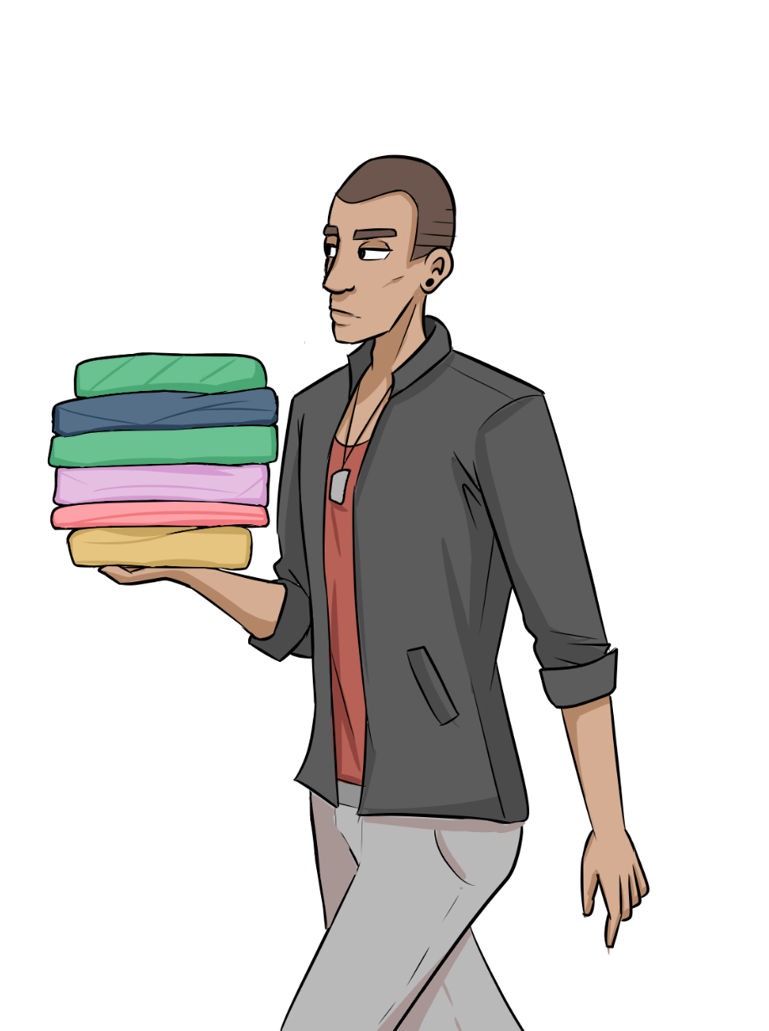


Reserve Requirements
If Tia, Eric and Ryan withdrew their entire bank balance at once, the bank wouldn’t have enough money in the vault to pay them.
-$100
-$150
-$200
Notes:
The bank only has $200 in the vault (from Tia) the other $350 cannot be withdrawn. The Reserve Requirement prevents this from causing the bank to collapse.

Slide 11
Reserve Requirements
The bank only has $200 in the vault (from Tia).
However, if for some reason the bank is short on cash, they can borrow from another bank or the Federal Reserve in the short-term.
Notes:
The Reserve Requirement prevents this from causing the bank to collapse. Some financial institutions, like mortgage banks, only issue loans, and borrow money from other banks to finance it instead of relying on customer deposits.
If the bank fails completely and goes out of business, the FDIC insures all deposits, so nobody ever loses their money.

Slide 12

Reserve Requirements
The Federal Deposit Insurance Corporation, (FDIC) is an independent agency of the US government that provides deposit insurance to depositors in US banks.
Notes:
Image reference: FDIC (history.com)
The FDIC was created in 1933 in response to the widespread bank failures during the Great Depression.
Its primary purpose is to maintain stability and public confidence in the nation's banking system by insuring the deposits of bank customers up to a certain limit.
The FDIC also promotes sound banking practices and assists in the resolution of failed banks.

Slide 13
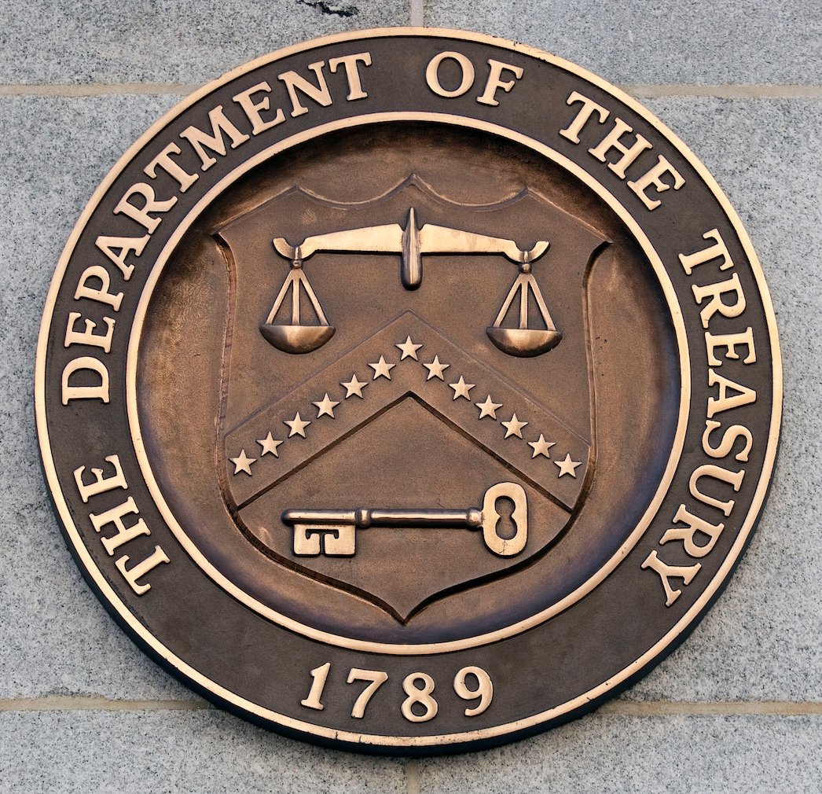
Relationship with the Government
The government obtains revenue through taxes and selling Treasury Bonds to investors and banks, which creates the initial cash "seed" for lending.
Notes:
Example: The United States 10-year Treasury bond.
This bond is issued by the U.S. Department of the Treasury and has a maturity period of 10 years.
It pays interest every six months throughout its tenure and returns the principal amount to the bondholder at maturity.
Treasury bonds are considered to be a low-risk investment as they are backed by the full faith and credit of the U.S. government.
They are widely used by investors seeking a stable and predictable income stream.
Image reference: Treasury Department moves 450 employees to - The Washington Post
The U.S. Department of the Treasury seal is displayed outside of the headquarters in Washington, D.C. (Andrew Harrer/BLOOMBERG)

Slide 14
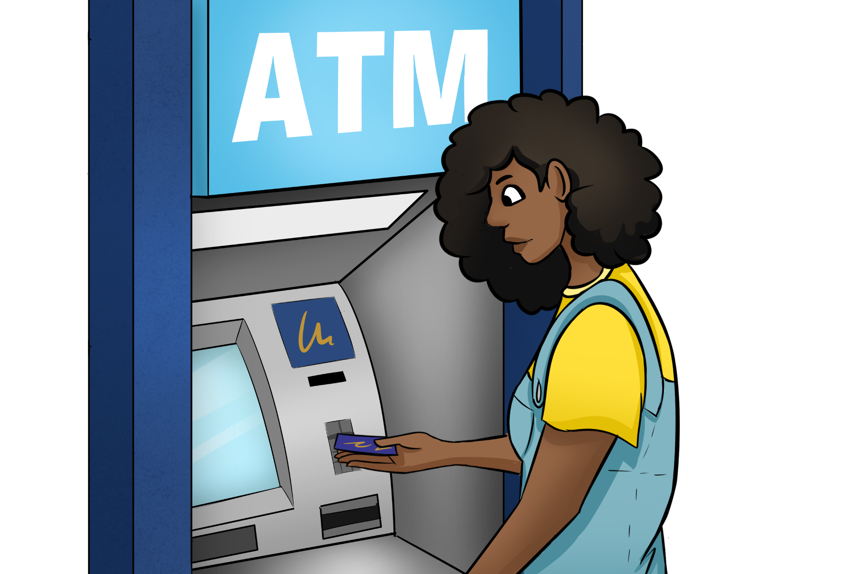
Trust and Money Creation
Money creation relies on the trust depositors have in the banking system.
Depositors believe their money is safe and can be accessed when needed.
Lending and money creation support economic activity and investment.
Notes:
Money creation relies on the trust depositors have in the banking system.
Depositors believe their money is safe and can be accessed when needed.
Lending and money creation support economic activity and investment.

Slide 15
Currency Backing
The value of the dollar is based on all the loans that created the money to begin with.
Money has value because we trust most people will pay back their loans.
We charge interest on loans to protect against some loans defaulting (not being repaid).
If too many loans are not repaid, the money supply contracts, which can cause deflation and a recession.
Notes:
Example: When a loan is used to start a business, the money borrowed is used to purchase equipment and hire employees, which generates economic activity and contributes to the value of the currency.
Currency today is indirectly backed by the value of goods and services produced using borrowed funds.
Money created through debt supports economic activities and production.
A currency's value is derived from the underlying economic output of its nation.

Slide 16

The Gold Standard
Historically, the total amount of money in circulation was directly proportional to the amount of gold mined.
Banks had to physically move gold reserves between them for transactions.
The Gold Standard was ended in the United States in 1976.
Notes:
Example: Under the Gold Standard, when someone wrote a check from one bank to another, the first bank had to physically ship gold to the second bank to settle the transaction. This process was costly and time-consuming.

Slide 17
Discussion Questions
How does the creation of money through loans impact the total amount of money in circulation?
Notes:
Money through loans increases the money supply, (the total amount of money in circulation at any given time).

Slide 18
Discussion Questions
What is the role of reserve requirements in preventing banks from loaning out the same dollar infinitely?
Notes:
Reserve requirements prevent people from panicking that their bank can't pay them back and "run on the bank" withdrawing all their money, causing a bank collapse.

Slide 19
Discussion Questions
Why did the United States move away from the Gold Standard and how did this change the way money is created and backed?
Notes:
The main departure from the gold standard was that the money supply was no longer based on how much gold we could mine - it was based on how much money was actually needed (through loans).

Slide 20
Key Takeaways
Money in the United States (and many other countries) is created as a form of debt.
Banks create loans for people and businesses.
Reserve requirements prevent banks from loaning out the same dollar infinitely.
Money created by debt is ultimately used to produce goods and services.
The Gold Standard was ended in the United States in 1976.
Today, currency is indirectly backed by the value of goods and services produced using borrowed funds.
Notes:
Money in the United States (and many other countries) is created as a form of debt.
Banks create loans for people and businesses.
Reserve requirements prevent banks from loaning out the same dollar infinitely.
Money created by debt is ultimately used to produce goods and services.
The Gold Standard was ended in the United States in 1976.
Today, currency is indirectly backed by the value of goods and services produced using borrowed funds.

