Slide 1

Inflation
Understanding the Impact of Inflation on Your Finances
Copyright Stock-Trak, Inc. 2023-2024

Slide 2

What Is Inflation?
Inflation is the increase in the general prices of goods and services from one year to another.
Inflation reduces the buying power of a fixed income, as the cost of goods and services goes up.
Notes:
Inflation is the increase in the general prices of goods and services from one year to another, which reduces the buying power of a fixed income. It is a normal part of the economy but can erode savings and impact consumers' purchasing power.
Overall, inflation can have complex and wide-ranging impacts on the economy, affecting consumers, businesses, and financial markets. Managing inflation is an important goal for policymakers to maintain price stability and support sustainable economic growth.
Image Note: The economy is like a balloon – some inflation is needed to keep it afloat, but too much can make it pop

Slide 3
Interest Rates (Nominal vs Real)
Nominal interest rate is the stated interest rate on a loan or investment.
Real interest rate is the nominal interest rate adjusted for inflation, representing the true purchasing power and the actual return or cost of borrowing.
Notes:
Nominal interest rate: The nominal interest rate is the stated interest rate on a loan or investment. It does not account for the impact of inflation and reflects the interest earned or paid without considering changes in purchasing power over time.
Real interest rate: The real interest rate considers the impact of inflation on the nominal interest rate. It is the nominal interest rate adjusted for inflation, representing the true purchasing power and the actual return or cost of borrowing. The real interest rate provides a more accurate measure of the profitability of investments or the cost of borrowing when considering the eroding effects of inflation.

Slide 4

How Do You Measure Inflation?
The main way economists measure inflation is with the Consumer Price Index (CPI).
CPI compares the prices of a set basket of goods between years.
Notes:
Consumer Price Index (CPI):
Benefits:
- Widely-used measure of inflation
- Transparent and easy to understand
- Used for calculating Social Security benefits
- Reflects price changes in a set basket of goods
- Considers variations in consumption patterns with subtypes like CPI-W
Negatives:
- Not a good match for everyone as consumption patterns vary across different regions and demographics
- Basket of goods does not change, making it less reliable over time
- Chained CPI attempts to address this, but is less transparent and provides lower inflation estimates

Slide 5
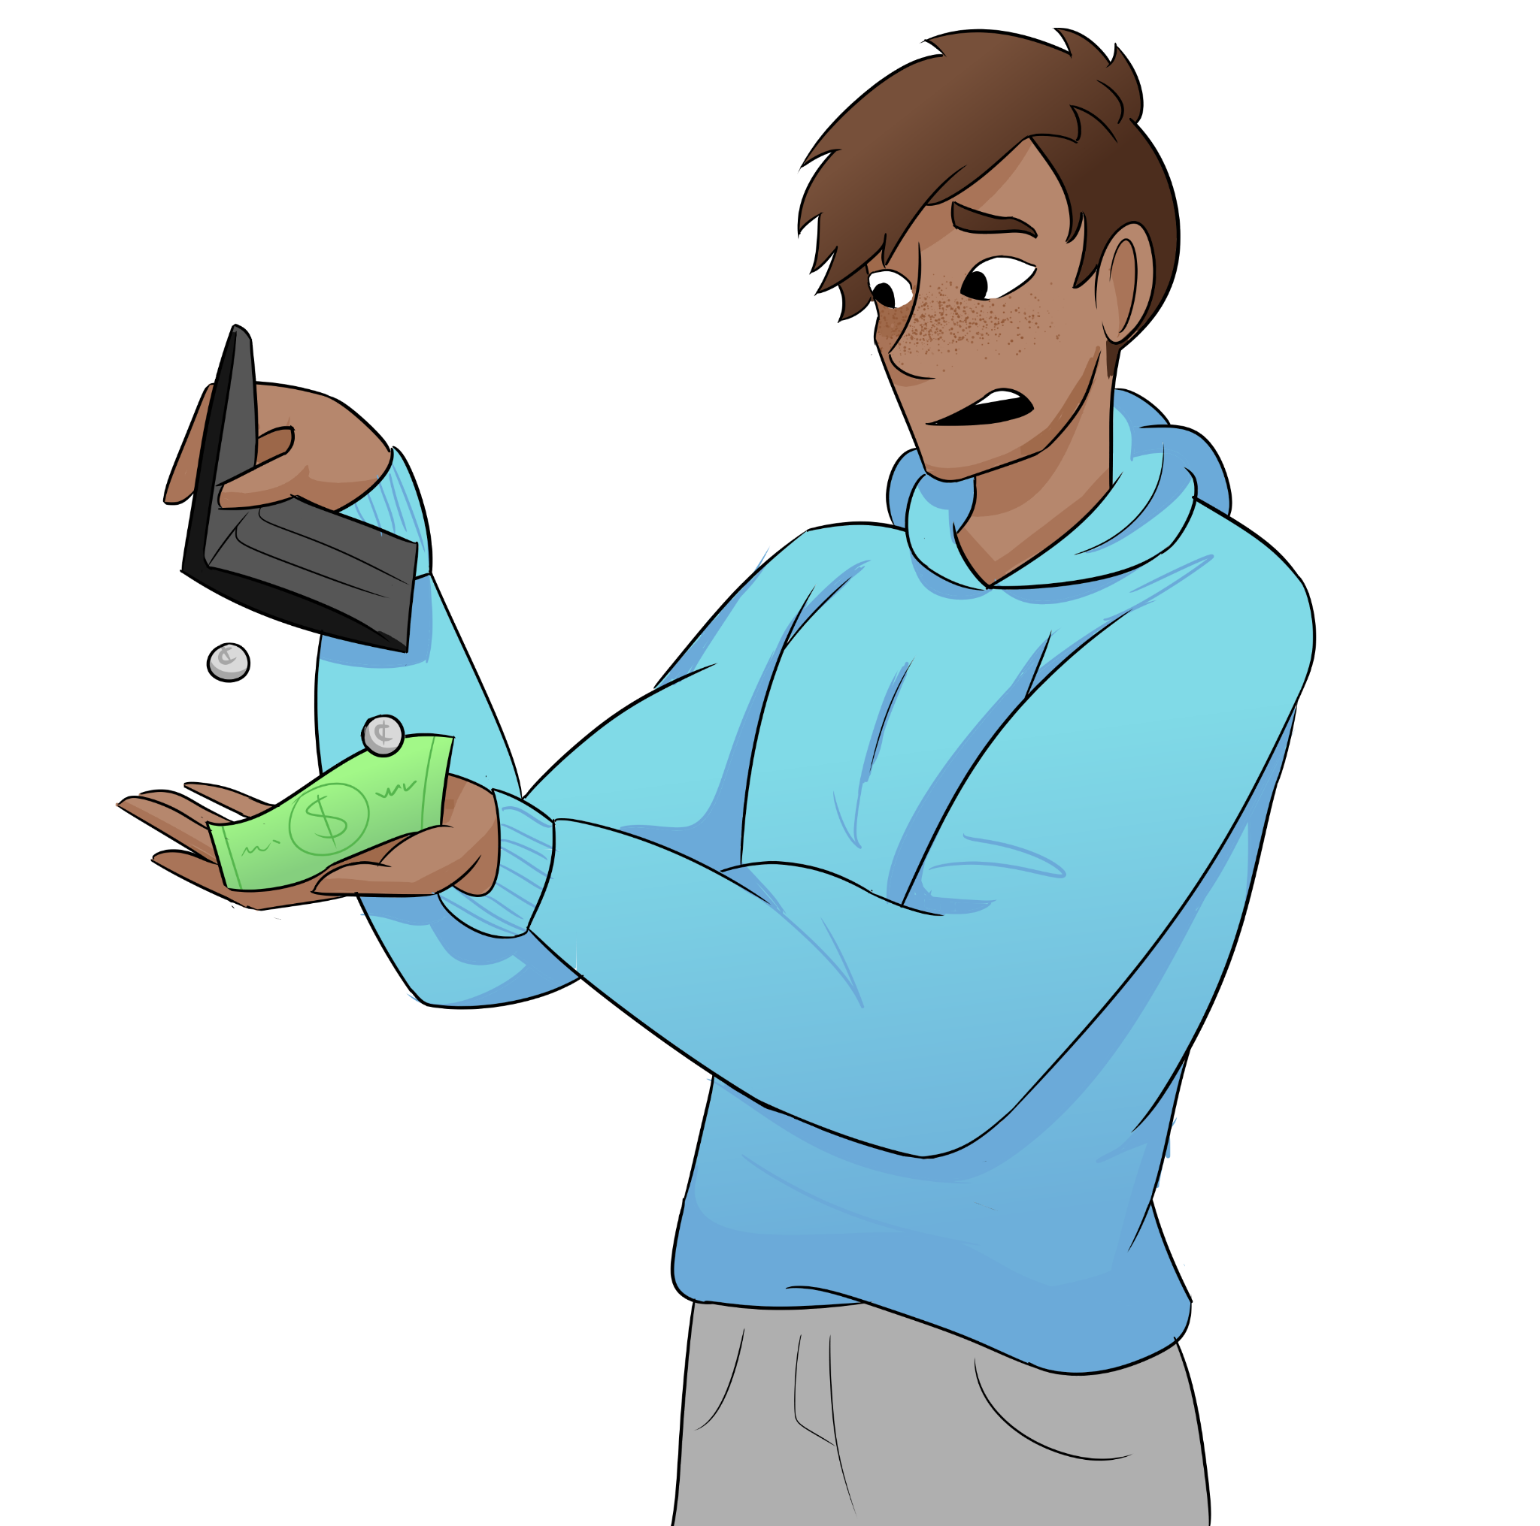
Reduced Purchasing Power
Prices increase for goods and services.
Each unit of a currency buys less over time.
People cannot save as much money.
More of their income gets spent to pay for the same level of comfort as before.
Notes:
As inflation increases the general price level of goods and services increases, eroding the purchasing power of money. This means that each unit of currency can buy fewer goods and services over time.
The negative impact on individuals: reduced purchase power increases spending because people can't save as much - more of their income gets spent to pay for the same level of comfort as before.
The negative impact on businesses: their costs go up (and so profits go down).

Slide 6
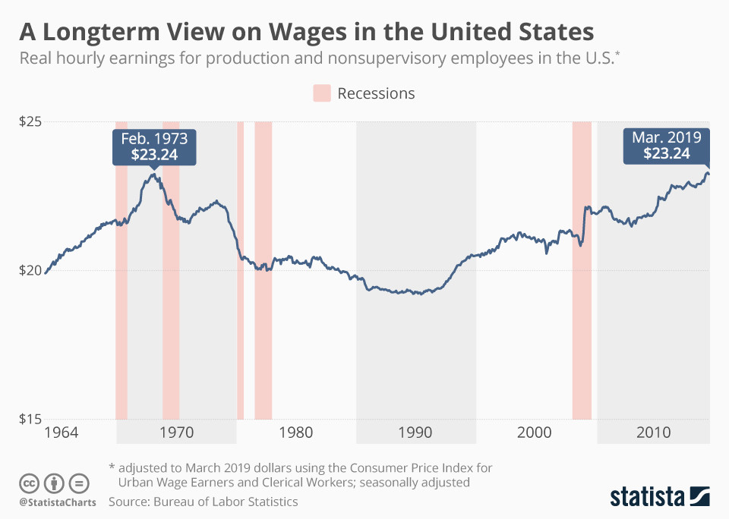
Wage-Price Spiral
Typically begins with wage increases demanded by workers.
As wages increase, businesses pass on the higher labour costs to consumers.
As prices rise, workers demand even higher wages to maintain their purchasing power.
Notes:
- The wage-price spiral is a phenomenon where wages and prices continuously increase in a self-reinforcing cycle.
- It typically begins with wage increases demanded by workers due to factors such as inflation, increased cost of living, or higher productivity.
- As wages increase, businesses pass on the higher labor costs to consumers through higher prices for goods and services, causing inflation.
- As prices rise, workers demand even higher wages to maintain their purchasing power, continuing the cycle.
- Employers are under no obligation to pay their employees more just because CPI is up. Wages increase due to low unemployment.
- When the economy is doing well, more businesses are hiring, and there are a finite number of employees to go around.
- So businesses raise wages to keep current employees and try to attract new ones (inflation and unemployment are USUALLY opposites).
- Companies pay higher wages to attract more employees, so they have to raise prices to pay for it. This means the "inflationary pressure" only exists so long as companies are expanding, and it stops when there is a recession.
Image Reference: 50 years of US wages, in one chart | World Economic Forum (weforum.org)

Slide 7
Eroding Interest Rates
You have $1,000 saved in a bank account, with an annual interest rate of 2%.
The inflation rate is 3%.
Your $1,020 (initial amount plus interest) may have increased, but the buying power is less than $1000 a year ago.
Your saved $1K is now worth the buying power of $990 a year.
Notes:
If the interest you earn is less than inflation for that year, your real savings actually loses value.
The real interest rate can be negative!

Slide 8

Promoting Growth
Individuals and businesses choose to invest and spend rather than keeping money in low-yield savings accounts.
This increased spending and investment can stimulate economic activity and contribute to growth.
Notes:
Central banks often use inflation as a tool for promoting economic growth by pursuing expansionary monetary policies. By increasing the money supply and lowering interest rates, central banks aim to stimulate borrowing, investment, and consumer spending, which can spur economic growth.
Inflation is closely tied to the long-term growth of both the economy and the money supply. As the economy grows, demand for goods and services increases, leading to rising wages, investment, and employment opportunities. This positive cycle of growth can be sustained by moderate inflation.
As wages and prices rise with inflation, borrowers may find it easier to repay their debts as the real value of the debt decreases. This can improve debt dynamics, increase financial stability, and promote further borrowing for investment and growth.

Slide 9
Hyperinflation
Hyperinflation occurs when excessive amounts of money are injected into the economy at a rate that surpasses the pace it can be repaid.
The Federal Reserve adjusts interest rates to balance borrowing and economic growth, aiming to prevent both hyperinflation and deflation.
Notes:
Hyperinflation occurs when excessive amounts of money are injected into the economy at a rate that surpasses the pace it can be repaid.
The Federal Reserve adjusts interest rates to balance borrowing and economic growth, aiming to prevent both hyperinflation and deflation.
One example of hyperinflation in the real world is the case of Zimbabwe in the late 2000s.

Slide 10
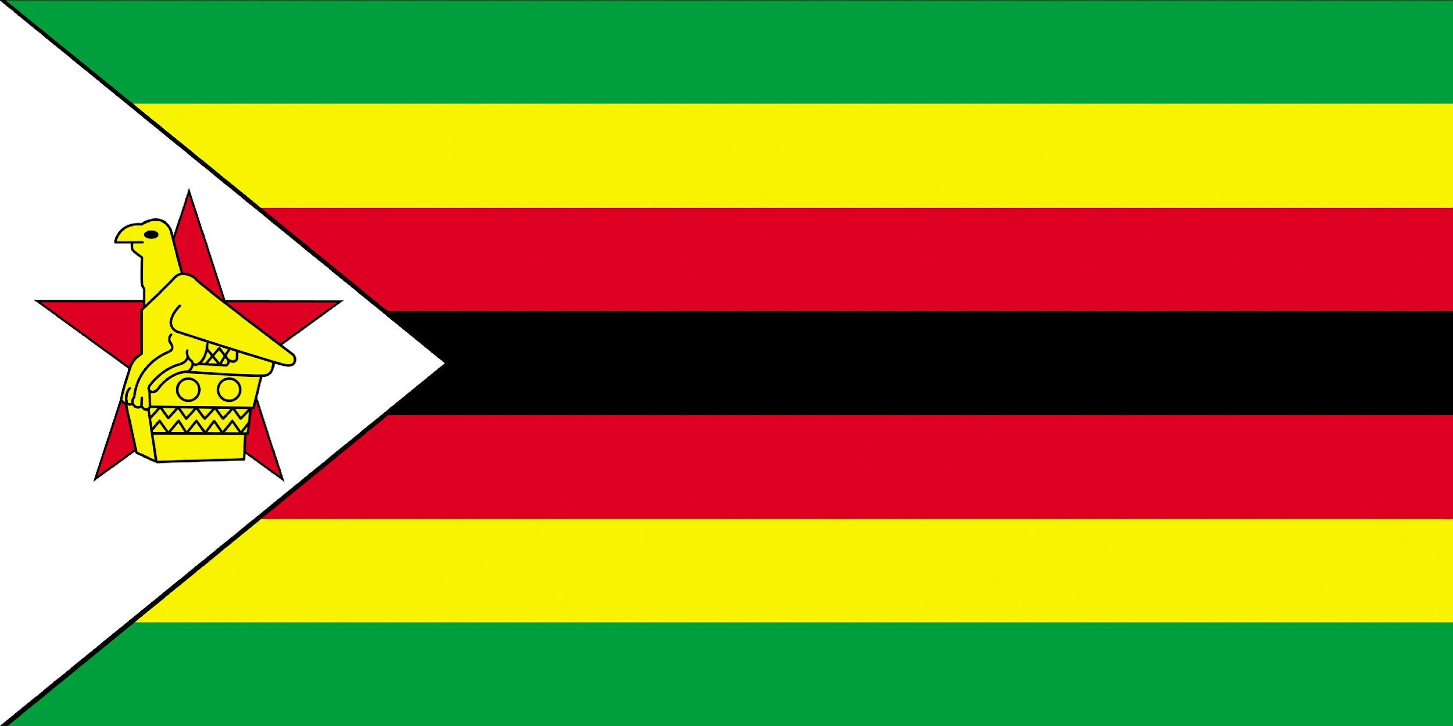
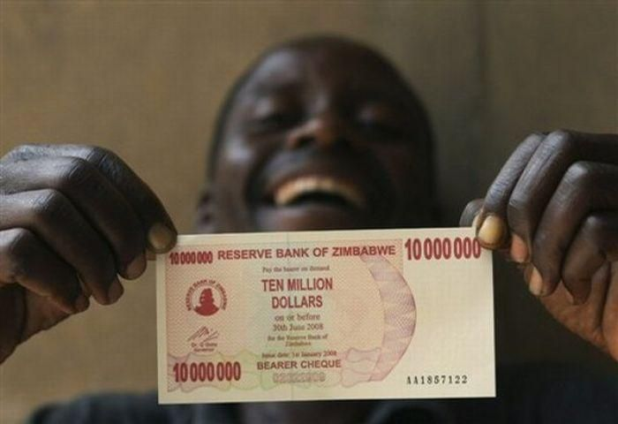
Hyperinflation in Zimbabwe
Zimbabwe's economic decline was due to government policies and poor economic management.
Land seizures, excessive money printing, and the prices of goods and services skyrocketed daily.
People struggled to afford necessities and savings were lost.
At its peak in 2008, the inflation rate was ~80 billion%/month!
Economy collapsed, high unemployment,
social and political instability
Notes:
In the early 2000s, the Zimbabwean government implemented a series of economic policies that led to a severe economic decline. These policies included land seizures, the printing of money to fund government expenses, and poor economic management.
As a result, hyperinflation spiraled out of control. Prices of goods and services skyrocketed on a daily basis, making it almost impossible for people to afford basic necessities. At its peak in 2008, the inflation rate in Zimbabwe reached an estimated rate of 80 billion percent per month.
The hyperinflation crisis in Zimbabwe had severe consequences. People lost their savings and struggled to afford food and necessities. The economy collapsed, unemployment soared, and the country experienced significant social and political instability.
This example illustrates the devastating impact that hyperinflation can have on an economy and the daily lives of its citizens.

Slide 11
Deflation
Deflation is the decrease in general prices of goods and services over time, resulting in an increase in the purchasing power of money.
Deflation, or negative inflation, can have negative effects on the economy by causing hoarding of cash and reducing economic activity.
Notes:
Deflation is the decrease in general prices of goods and services over time, resulting in an increase in the purchasing power of money.
Deflation, or negative inflation, can have negative effects on the economy by causing hoarding of cash and reducing economic activity.
If the economy looks like it is heading for deflation, the Federal Reserve will lower interest rates to encourage more borrowing and spending to prevent a recession.

Slide 12
Discussion Questions
Why might deflation be bad for the economy?
Notes:
It’s bad for investing, less incentive for making investments: Deflation erodes profitability and reduces the return on investment. Companies may find it challenging to generate profits as their revenues decline. Consequently, businesses may cut back on investment, resulting in reduced employment opportunities, less innovation, and slower economic growth.
Decreased consumer spending: In a deflationary environment, consumers may delay purchases as they anticipate further price declines. This reduced spending can lead to decreased demand for goods and services, resulting in lower production levels and potential job cuts. Lower consumer spending can also amplify the deflationary cycle, as lower demand further drives down prices.
Increased debt burden: Deflation increases the real value of debt since prices are declining. Individuals and businesses having loans will find it harder to repay their debts as the value of their income and assets erode. This can lead to defaults, bankruptcies, and financial instability.
Negative impact on wages: In deflationary periods, firms may find it difficult to adjust wages downward, leading to higher real wages. As a result, firms may be compelled to reduce labor costs through layoffs, thus increasing unemployment rates.

Slide 13
Discussion Questions
How does inflation impact the buying power of consumers?
Provide examples.
Notes:
Reduced standard of living: Inflation erodes the purchasing power of income. If wages do not keep up with inflation, consumers may find it difficult to maintain their previous standard of living. Inflation can lead to a decline in real wages, forcing individuals to cut back on their spending or rely more heavily on credit.
Increased cost of borrowing: Inflation can lead to higher interest rates, which can increase the cost of borrowing for consumers. This includes mortgages, car loans, and credit card debt. As the cost of borrowing rises, it becomes more expensive for consumers to make large purchases or invest in long-term assets.
Uncertainty and financial planning challenges: Inflation introduces uncertainty into the economy and makes financial planning more challenging. Consumers may find it difficult to accurately predict future prices and plan for future expenses. This uncertainty can lead to hesitation in making long-term financial decisions, such as investments or major purchases. Their savings erode overtime, making it even more challenging to make financial decisions.
Uneven Impact on the Economy: Inflation can have an uneven impact on different groups of consumers, it doesn’t happen evenly in an economy. Some items will become more expensive, while others become cheaper.
(example: CostCo never raises prices on hot-dogs, so if a company raises prices for their stuff and pay their employees more, they can buy more CostCo hot-dogs)
Also, those with fixed incomes or assets denominated in cash may suffer as the purchasing power of their money decreases. On the other hand, individuals with flexible incomes, investments in assets that appreciate with inflation (like real estate or stocks), or the ability to negotiate wage increases may fare better during inflationary periods.

Slide 14
Discussion Questions
How does inflation erode the value of savings?
Explain the concept of real interest rates.
Notes:
The 'real' interest rate on a savings account or loan reflects that the value of a dollar is not the same over time, due to inflation.
The "real" interest rate is never really seen.
Example: A savings account is paying 1% interest, but inflation is 3%, so the "real" return on savings is -2%. So the saver might look for other ways to build their savings (like investing), which is a main driver behind economic growth
Inflation can adversely affect savers and individuals on fixed incomes. If the rate of inflation exceeds the rate of return on savings or fixed-income investments, the real value of those savings or investments decreases. This can pose problems for retirees and individuals who rely on income from fixed sources.

Slide 15
Discussion Questions
How does inflation promote economic growth?
Discuss the role of spending and investment in the economy.
Notes:
Inflation can incentivize individuals and businesses to spend and invest rather than hoard money. When people expect prices to rise in the future, they have an incentive to spend or invest their money in order to avoid the erosion of its value. This increased spending and investment can stimulate economic activity and contribute to growth.
Moderate inflation can help to reduce the real burden of debt. As the general price level rises, the value of money decreases, making it easier for borrowers - including individuals, businesses, and governments - to repay their debts in real terms. This can reduce financial stress, encourage borrowing, and stimulate investment and economic growth.
Inflation provides a mechanism for relative price adjustments. When the overall price level rises, some prices will increase more than others. This allows for relative price changes, which help to allocate resources more efficiently across different sectors of the economy.

Slide 16
Discussion Questions
What are the potential consequences of extreme cases of inflation, such as hyperinflation?
Notes:
Hyperinflation: it can cause people to stop using money altogether and resort to bartering, or using another country's currency. A country loses all ability to guide their economy. Plus everyone loses their savings and nobody is willing to invest.

Slide 17
Key Takeaways
Inflation is the increase in the general prices of goods and services.
Inflation reduces the purchasing power of money.
Inflation is measured with the Consumer Price Index (CPI).
Inflation erodes interest rates and promotes economic growth.
Hyperinflation can cause economic collapse.
Notes:
1. Inflation is the increase in the general prices of goods and services.
2. Inflation reduces the purchasing power of money.
3. Inflation is measured with the Consumer Price Index (CPI).
4. Inflation erodes interest rates and promotes economic growth.
5. Hyperinflation can cause economic collapse.

