Slide 1

Monetary Policy
Part 2 - Managing the Money Supply & Interest Rates
Copyright Stock-Trak, Inc. 2023-2024
Notes:
This presentation is best preceded by The Federal Reserve presentation.

Slide 2

Monetary Policy is…
The use of tools and actions by the government
to control and influence factors
such as interest rates and the money supply
to achieve economic goals.
Notes:
A simple definition before diving into more detail on the following slides.

Slide 3
Money Supply
Definition: refers to the total amount of money, both physical cash and various types of deposits, available in an economy at a given time.
Divided into 4 categories based on liquidity:
M0. Cash
M1. Cash + Checking Accounts
M2. Cash + Checking + Savings
M3. Cash + Checking + Savings + Money Markets
Notes:
Liquidity refers to the ease with which an asset or investment can be quickly bought or sold without affecting its price.
M0 (a.k.a monetary base) represents all physical currency and coinage that is circulating within the economy. This includes the cash in people's pockets, purses, home safes, as well as the cash resting in bank vaults. Additionally, it covers coins used for exchange in an economy.
For example: if Susan has $50 in her wallet, and her bank has $5,000 in its vault, and Tom has $200 in his piggy bank at home, the M0 money supply is $5,250.
M1 is a narrow measure of money's function as a medium of exchange. It entails all physical currency (like M0) but additionally includes checking deposits. Checking deposits are bank accounts that allow very liquid access including access via checks, debit transactions, and e-transfers.
For example: if Susan has $50 in cash and $70 in her checking account, and Tom has $200 cash and $1,000 in his checking account, the M1 money supply here is $1,320.
M2 includes M1 plus short-term time deposits in banks, certain money market funds, and savings deposits. It basically widely measures the supply of financial assets redeemable at short notice.
For example: let's add Diane to our scenario. Diane has $300 cash, $2,000 in her checking account, and $5,000 in her saving account. Combining Susan's, Tom's, and Diane's money supplies, we have an M2 money supply of $8,620.
M3, the broadest measure of money, encompasses M0, M1, M2, and all other financial assets that can be quickly converted into M1 or M2. This can include large time deposits, institutional money market funds, short-term repurchase agreements, and other larger liquid assets.
For example: let's add John. John has $500 cash, $2,500 in his checking account, $7,000 in his savings account, and $12,000 in money market accounts. Adding to the M2 money supply of $8,620 we calculated earlier, the total for M3 money supply would be $30,620.

Slide 4
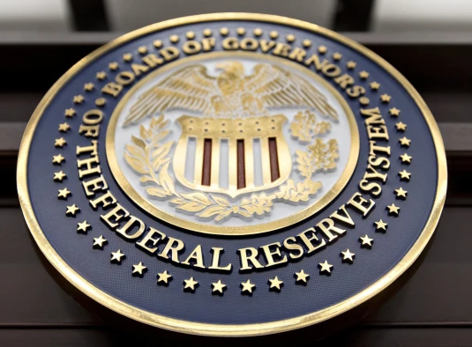
Role of Federal Reserve
The Federal Reserve Bank sets monetary policy in the United States. Their goals are to:
Encourage economic growth
Manage the money supply
Control inflation.
Notes:
Please see The Federal Reserve presentation for more information.
Image Reference: Bloomberg, Lessons from the credit crunch (ft.com)

Slide 5

Inflation & Growth
Economic growth is funded by borrowing.
Most businesses take out loans to fuel their own growth.
If the economy is growing = more loans today than yesterday.
Money Supply grows before the rest of the economy causing some inflation.
Notes:
Borrowing acts as a catalyst for businesses to expand, invest in infrastructure, hire more employees, and fuel innovation.
For example: if a tech startup borrows $1 million to develop an innovative product, this loan paves the way for production, job creation, and eventually, economic growth.
As the economy grows, it nurtures confidence in the economic climate and encourages businesses to borrow and invest more. If a company sees its profits grow, it's likely to take on more debt for expansion knowing it can pay it off. When new loans are issued, they add to the supply of money in circulation because banks create new money whenever they loan. If the amount of loans is increasing, the money supply grows.
An increase in the money supply can lead to some inflation. This is because when more money is in circulation whilst the amount of goods and services stays the same, prices can rise.

Slide 6
Inflation Example
Step 1: Business takes out a loan (increasing the money supply).
Step 2: Business uses the loan to hire a new employee, and pays the their first paycheck (putting the money into circulation).
Step 3: The business provides a service to one of its clients, and gets paid for it (generating a profit).
Step 4: The business pays back its loan.
Notes:
Another example: if a business takes a large loan to expand its manufacturing capability over the next two years. In the immediate term, the loan increases the money supply, potentially elevating prices slightly. However, when the manufacturing plant is finished and starts producing more goods, this can offset the earlier inflation by increasing the overall supply of goods.

Slide 7

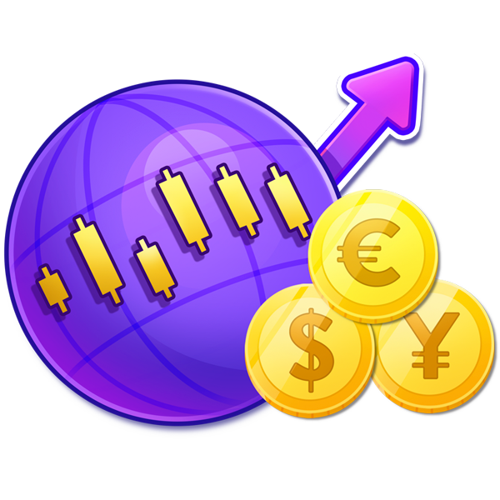
Runaway Inflation
Definition: occurs when too much money enters the money supply without being paid back, causing prices to rise without any extra value being added to the economy.
Businesses anticipate 'expected' inflation, leading to price hikes.
Savings lose value.
Paychecks are worth less.
The Federal Reserve uses monetary policy to balance inflation and growth
Notes:
The Federal Reserve uses monetary policy to balance inflation and growth. Encouraging business expansion while curbing runaway inflation (hyperinflation). Here are some examples from around the world where this happened and how the local governments responded.
Germany (1923): The Weimar Republic printed massive amounts of money to pay off war debts, which led to hyperinflation, with prices doubling every 3.7 days at its peak. The government introduced the Rentenmark, a new currency backed by real estate, to replace the volatile Reichsmark and stabilize the economy.
Zimbabwe (2000s): The government began to print money to pay for its war in Congo and domestic programs. By 2008, annual inflation had reached over 231 million percent. Zimbabwe abandoned its national currency in 2009 and allowed the use of foreign currencies like the US dollar and the South African rand.
Argentina (1989-1990): Poor economic policies and extensive monetary growth led to inflation rates of over 5000%. In response, Argentina introduced a new currency, the Austral. Ultimately, it had to implement drastic measures, such as pegging the Argentine peso to the US dollar in 1991.
Venezuela (2010s): High inflation started with the fall of oil prices and the government's decision to start printing more money. By 2018, inflation had risen to 130,060% and in 2020, it reached a peak of over 6,500%. Venezuela issued a new currency, Bolivar Soberano, to replace Bolivar Fuerte, to counter hyperinflation.
Hungary (1946): After World War II, Hungary experienced the worst hyperinflation in history, peaking at 41.9 quintillion percent per month. The government implemented drastic reforms, such as introducing a new currency, the Forint, in 1946 to replace the Pengő, ending the hyperinflation.

Slide 8

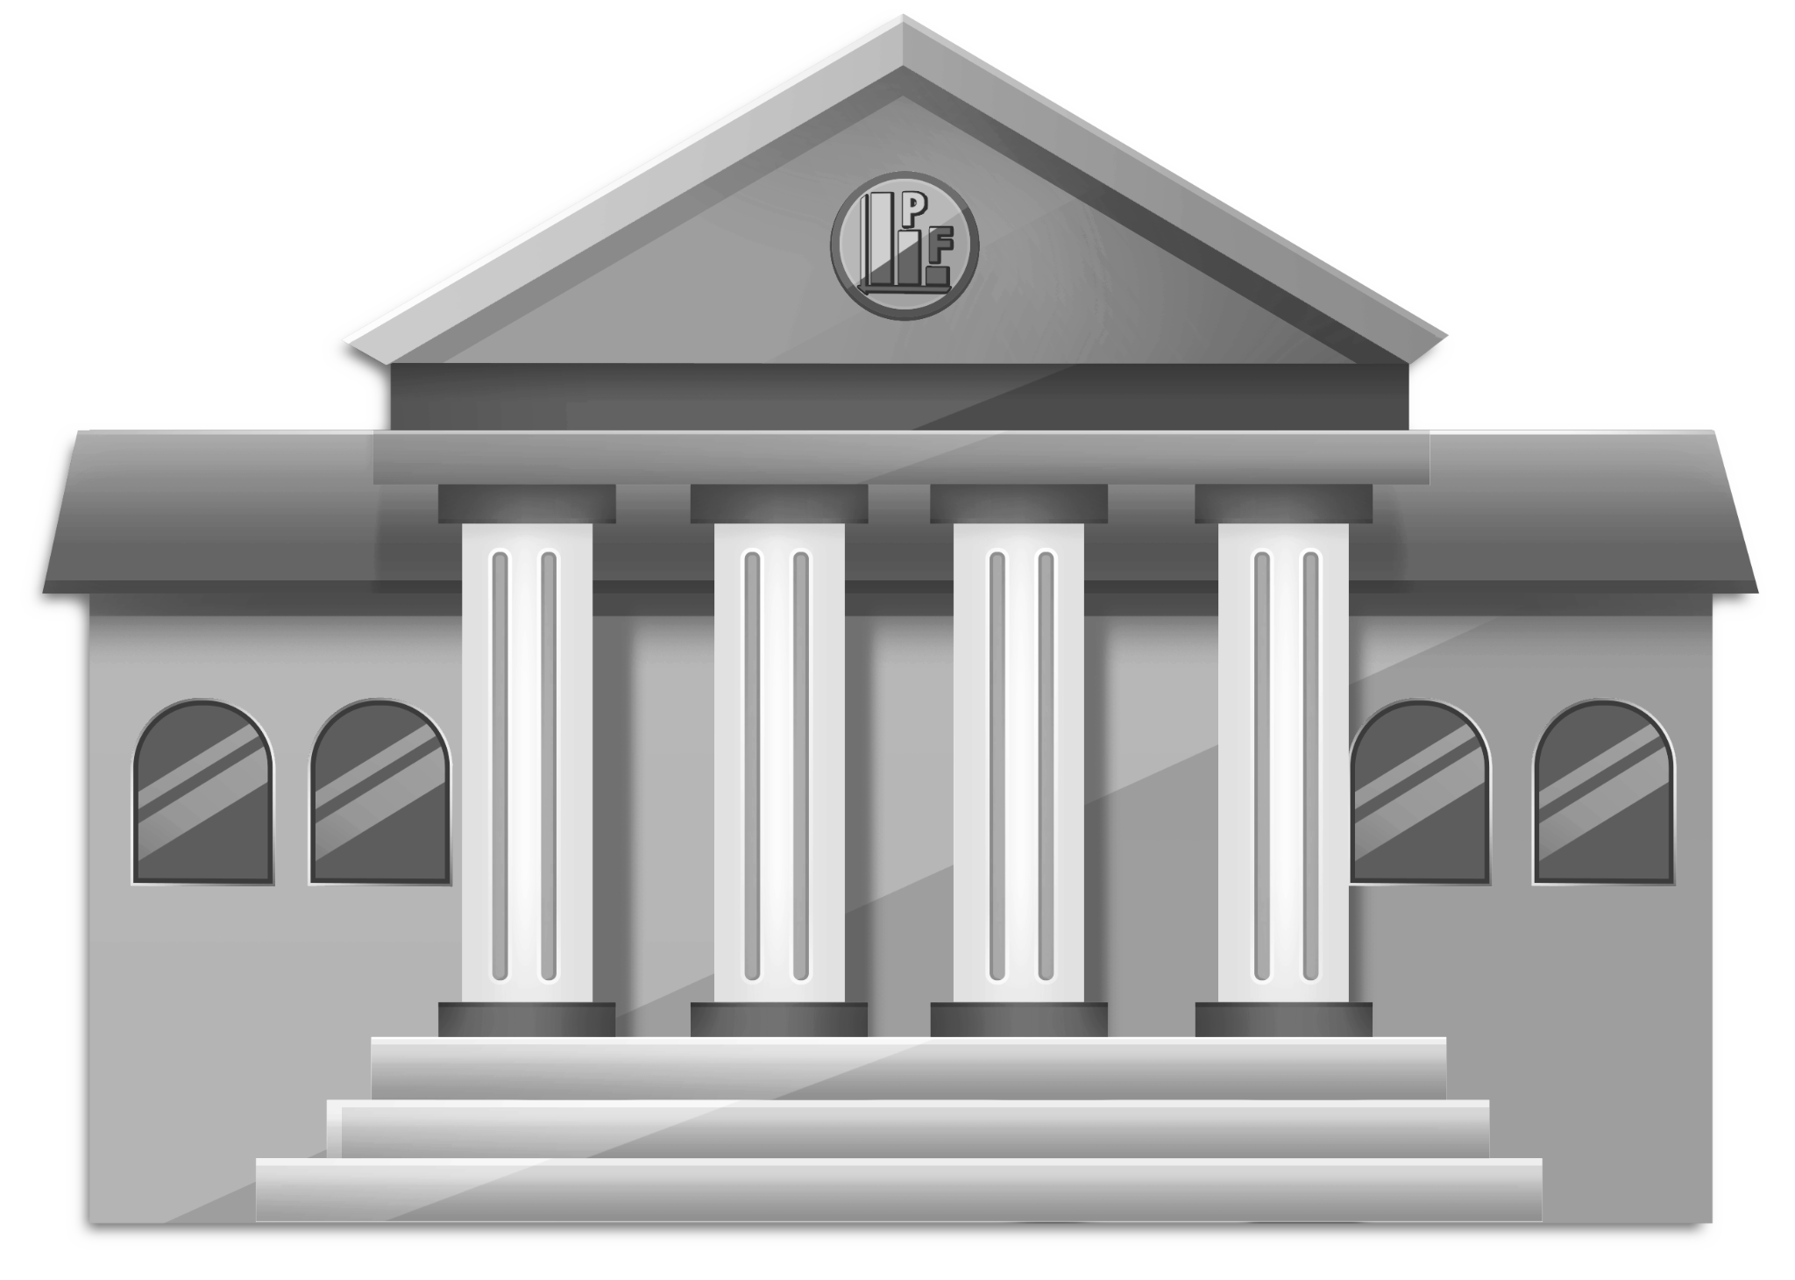
Federal Reserve Tools
Manipulating Interest Rates
Reserve Requirements
Bond Buying
Notes:
In the following slides, we go over each of these in more detail.

Slide 9
Manipulating Interest Rates
Definition: the rate banks lend money to each other at, the baseline risk-free rate. Also called the ‘Federal Funds Rate’.
If the risk-free rate goes up, all interest rates increase, discouraging borrowing.
Every month they announce whether rates are going up, down or staying the same.
Note: Limits exist to the efficacy of interest rate manipulation. High inflation with low growth makes interest rates ineffective.
Notes:
Interest rates are a key tool used by the Federal Reserve (or the Central Bank) to control inflation and stimulate economic growth. Cutting interest rates can boost borrowing and spending, which can stimulate growth. However, in the case of high inflation and low growth, known as stagflation, this tool's effectiveness is limited.
Since 2020, due to the impact of the COVID-19 pandemic, the U.S. has also experienced a period of low growth and increasing inflation. The Federal Reserve slashed interest rates to close to zero in an attempt to encourage spending and investment and stimulate economic recovery.
However, as the economy started to rebound and demand increased faster than supply in many sectors, prices began to rise. We've seen this phenomenon in industries from used cars to building materials. This is partly due to supply chain disruptions and pent-up consumer demand as restrictions ease, driving inflation up.
The traditional tool of the Federal Reserve - lowering interest rates to stimulate growth - becomes less effective in such a situation. Lower interest rates would normally stimulate borrowing and thus spending. However, when inflation is high, people are less inclined to spend as goods and services become more expensive.
So, we're in a situation of high inflation with weak growth - not a common occurrence in the US economy.

Slide 10
Reserve Requirements
Definition: rules that banks must follow for the amount of deposits they must keep in their vaults, (and not on loan).
They are a stabilizing tool for banks.
Lowering reserve requirements allows more lending, fueling growth.
A one-way tool, required to be increased once growth returns.
Note: Reserve requirements changes are rare, typically once per decade.
Notes:
The Federal Reserve announced in March 2020 that it was eliminating reserve requirements for all banks, allowing them to use cash previously held in reserve to extend credit and support the economy.
By eliminating these requirements, the Federal Reserve aimed to provide banks with greater flexibility, letting them inject more liquidity into the economy – crucial in dealing with the financial fallout of the COVID-19 pandemic.
This move was one among a suite of tactics used by the Fed to counteract economic downturn due to the pandemic, including slashing interest rates and launching numerous lending facilities.
Removal of the reserve requirement also reflected a long-term trend in macro-prudential regulation, as the use of reserve requirements for monetary policy purposes has declined over time, giving way to more direct instruments such as the influence of interest rates.

Slide 11
Bond Buying
Definition: Bond Buying or Quantitative Easing is an extreme monetary policy tool. The Federal Reserve buys and sells vast amounts of bonds to manipulate the market.
Developed in response to the 2007 crisis when rates couldn't be lowered.
Fears of economy shrinkage lead to bond investment, reducing money supply.
Notes:
Continued on next slide.

Slide 12
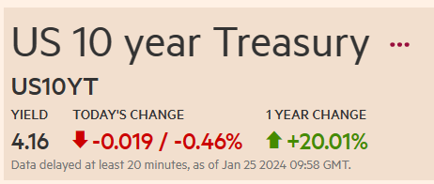
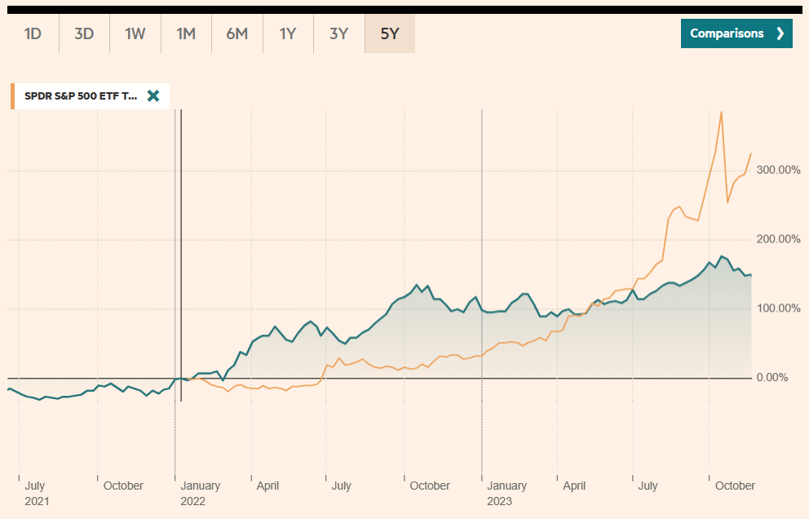
Bond Buying
Less money supply = fewer loans and limited growth.
Flooding the bond market decreases prices and bond returns.
This increases money supply and potentially stimulates growth.
Notes:
Investors see bonds as a less profitable, encouraging a return to other investments.
For students who are curious to know more about Quantitative Easing: Quantitative Easing and the Growth in the Federal Reserve’s Balance Sheet (congress.gov)
Image Reference: US 10 year Treasury Bond, chart, prices - FT.com, this chart is comparing the US 10-Year Treasury to the SPDR S&P500 ETF

Slide 13
Discussion Questions
Can you explain the relationship between inflation and growth, and how borrowing and spending contribute to both of these factors?
Notes:
Inflation is the rate at which the general level of prices for goods and services is rising, while growth refers to an increase in economic activity, such as an increase in Gross Domestic Product (GDP). These two economic concepts often impact each other in significant ways.
Positive Side of Inflation: When the economy is growing, consumers are more willing to spend money, and businesses are more likely to invest and expand. This increased demand often leads to an increase in prices, in other words, inflation. In moderate amounts, this cycle can be a positive sign, signaling that the economy is strong.
The Role of Borrowing: Borrowing is crucial to driving economic growth. Businesses often take loans to invest in expansion or new projects, which can create jobs, boost productivity, and thus stimulate economic growth. For individual consumers, borrowing might enable significant purchases such as homes or cars, contributing to overall economic activity.
Spending's Influence: Consumer spending plays a crucial role in driving both inflation and growth. When consumers are confident about the economy and their personal financial situation, they tend to spend more. This increased demand can help businesses grow and can also lead to higher prices, i.e., inflation.
The Inflation and Growth Tug of War: If inflation goes unchecked and becomes too high, it can harm economic growth. When prices rise rapidly, consumers' purchasing power can decrease, leading to reduced spending. This, in turn, can harm businesses and slow economic growth.

Slide 14
Discussion Questions
How does the timing of money entering the economy impact inflation levels?
Notes:
Inflow of Money & Inflation: Inflation is primarily a function of supply and demand. If more money enters the economy (increased supply) without a corresponding increase in goods and services (demand), it can lead to inflation, as there is more money chasing the same amount of goods.
Timing of Money Supply: The timing of money entering the economy is critical. If new money is created and enters the economy too quickly, it can cause inflation to spike. This is because the increase in money supply might outstrip the economy's capacity to produce more goods and services.
Short-Term vs. Long-Term Effects: In the short term, an influx of money can stimulate economic growth by increasing spending. People have more money to buy goods and services, leading to higher demand, which can boost production and create jobs. However, if the money supply continues to expand without corresponding increases in output, over the long term it will lead to inflation as more money is available to purchase the same amount of goods and services.
Role of Monetary Policy: It's vital to note that central banks play an important role here. They carefully manage and time the introduction of new money into the economy in an effort to stimulate growth without causing high inflation. This delicate balancing act is a fundamental aspect of monetary policy.

Slide 15
Discussion Questions
How effective do you think the current tools of monetary policy are in achieving the goals of economic growth and inflation control?
Notes:
Interest Rate Manipulation: Interest rates are a primary tool used by central banks to manage both growth and inflation. Lowering rates tends to stimulate economic growth by making borrowing cheaper, which can encourage businesses to invest and consumers to spend. Conversely, raising rates can help control inflation by making borrowing more expensive, which can cool an overheating economy. However, once interest rates hit zero or near-zero levels, the effectiveness of this tool is potentially reduced and can lead to a liquidity trap.
Reserve Requirements: By changing the reserve requirements, a central bank can influence the amount of money banks can loan out, thus influencing the money supply. Higher reserve requirements reduce the money supply which may help manage inflation, while lower reserves can boost the money supply aiding economic growth. This tool, however, is used infrequently and more so in developing economies.
Bond Buying (Quantitative Easing): Buying bonds increases the money supply and typically lowers longer-term interest rates, which can stimulate economic growth. This strategy, however, can risk inflating asset price bubbles, and if not managed correctly, can potentially lead to higher inflation.
In recent years, due to the low interest rate environment, central banks have been relying more heavily on so-called "unconventional monetary policy tools" such as quantitative easing. While these tools continue to hold importance, it's increasingly acknowledged that they cannot singlehandedly achieve economic growth and inflation control, especially in challenging economic circumstances. Thus, they need to be part of a broader, more flexible toolkit that includes fiscal policy measures.

Slide 16
Discussion Questions
Considering the recent economic crisis and the use of quantitative easing, how do you think the relationship between monetary policy and the stock market has evolved?
Does bond buying have unintended consequences for overall market stability?
Notes:
Monetary Policy and the Stock Market: Traditionally, the primary objective of monetary policy has been to maintain economic stability by controlling inflation and supporting job growth. However, with the recent economic crises and the implementation of quantitative easing, the relationship between monetary policy and the stock market has evolved significantly. Quantitative easing (QE) involves the purchase of long-term securities by central banks to infuse liquidity into the economy. This lowers long-term interest rates, leading to cheaper borrowing costs. While this is intended to stimulate economic growth, it has also led to a surge in asset prices, including the stock market in recent times.
Bond-Buying and the Stock Market: Lower interest rates can make bonds less attractive compared to stocks, resulting in a shift of investors from bonds to equities, which can inflate stock prices. This effect has been observed following rounds of QE after the global financial crisis and during the COVID-19 pandemic, with stock markets soaring even as the broader economy faced challenges.
Unintended Consequences: While bond buying and other monetary policy measures have aided economic recovery, they can also contribute to potential market instability. The surge in stock prices may not always reflect underlying economic fundamentals and can lead to overvaluation, which could pose stability risks if a market correction occurs.
Wealth Disparity: Another unintended consequence is the potential to exacerbate wealth disparity. Those with already substantial financial assets, including stocks, tend to benefit more from these rising asset prices, leading to increased wealth inequality.
Balancing Act: Central banks thus face a complex balancing act. While QE and low interest rates can be necessary for economic recovery, managing the potential side effects, such as inflated asset prices and wealth inequality, is challenging.
The Future of Monetary Policy: The evolving relationship between monetary policy and stock markets underlines the need for careful and considered policy decisions. In addition to traditional measures, consideration of macroprudential tools that aim to mitigate risks to the broader financial system is increasingly important. Monitoring market conditions, adjusting policies as needed, and clear communication will be key to maintaining market stability while supporting economic recovery.

Slide 17
Key Takeaways
Monetary policy is one of the ways the government tries to influence the economy in the United States.
The Federal Reserve Bank sets monetary policy with the goals of encouraging economic growth and controlling inflation.
Inflation and growth are closely related, as borrowing and spending increase the money supply and can lead to inflation.
The Federal Reserve has three tools for implementing monetary policy: manipulating interest rates, changing reserve requirements for banks, and bond buying (quantitative easing).
Notes:
Monetary policy is one of the ways the government tries to influence the economy in the United States.
The Federal Reserve Bank sets monetary policy with the goals of encouraging economic growth and controlling inflation.
Inflation and growth are closely related, as borrowing and spending increase the money supply and can lead to inflation.
The Federal Reserve has three tools for implementing monetary policy: manipulating interest rates, changing reserve requirements for banks, and bond buying (quantitative easing).

