Slide 1
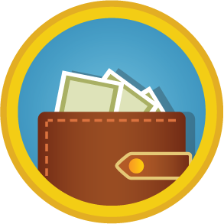
Receipts
Keeping and Tossing
Personal Finance Lab

Slide 2
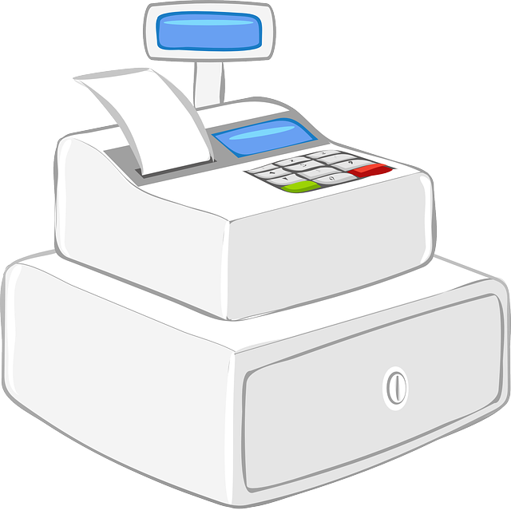
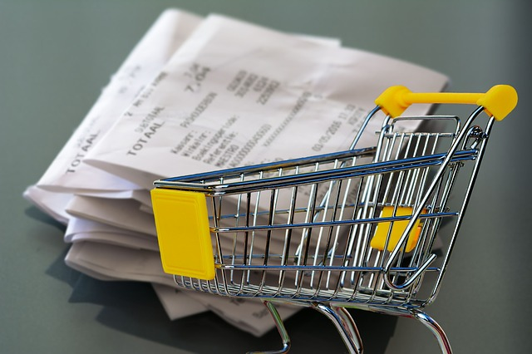
Receipt 101
What is a Receipt?
A receipt is a piece of paper that you recieve after you make a transaction with someone. For every transaction that you complete you should receive some type of receipt.
Why is this important?
It is important to keep track and obtain receipts because this will allow you to keep track of your purchase which will help you stay on budget.

Slide 3
3 Types of Receipts
Will I want to return this purchase later?
If there is a possibility that you will return an item, it is important to keep the receipt. Make sure that you check the company's return policy (eg. how many days you have to return the product).
Throw out these receipts between 30-60 days
Is this purchase accounting for 10% or more of what I expect to spend this month?
If you think that a purchase will be 10% or more of your monthly it is important to save the receipt to make sure that the amount is correct and that you think about the purchase when planning you next budget.
Throw out these after your account reconciliation
Do I want to claim this purchase on my taxes?
If you think you can file the purchase on your taxes (Tution or Job Training, Work Uniform, Donation) then you should save the receipt because you might be able to get a tax break.
You should save these receipts for at least 7 years just in case the IRS audits you

