Slide 1

Supply & Demand
Examples in the Stock Market
Copyright Stock-Trak, Inc. 2023-2024

Slide 2
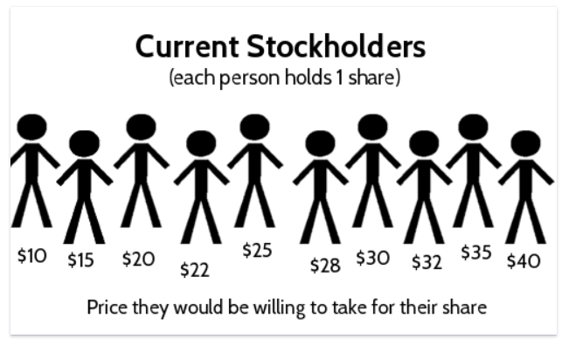
Supply
Supply refers to the total number of stockholders who would be willing to sell their shares at any given price.
As the price rises, the total number of shares supplied increases.
When the supply of a particular stock exceeds the demand, the stock price tends to fall.
Notes:
All these sellers value their share differently. The shareholders on the left would be willing to take a much lower price for their shares than the sellers on the right.
Factors influencing supply: production costs, pricing, technological advancements, competition, and governmental regulations.
When these factors result in high production, the supply increases. Conversely when these factors discourage production, supply decreases.

Slide 3
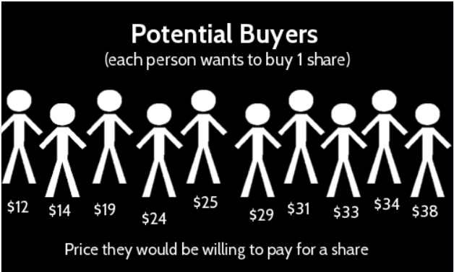
Demand
Demand refers to the total amount of stock potential buyers would be willing to buy at any price.
When the demand for a particular stock is high, the price tends to rise as more investors compete to buy it.
As the price rises, fewer people are willing to buy shares.
Notes:
Imagine we have 10 people who want to buy 1 share each, but are only willing to pay a certain price. Unlike supply, this means that as the price goes up, fewer people are willing to buy a share. For example, if the price per share was $30, only 4 people would be willing to buy (the 4 on the right side).
Factors influencing demand: income, preference, expectations, price of related goods etc.
If consumers want or need a product a lot, the demand is high. If consumers don't want or need a product much, the demand is low.

Slide 4
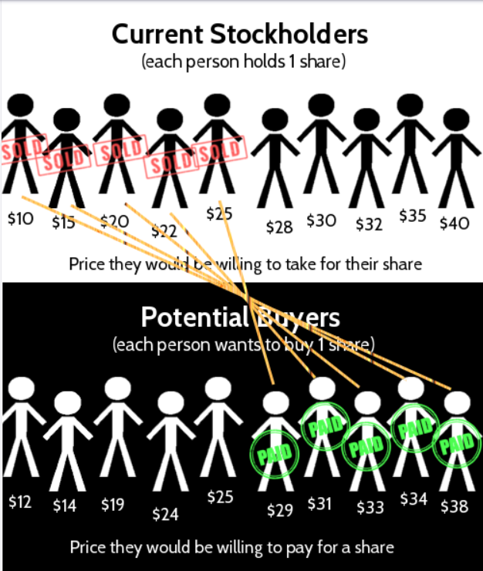
Market Equilibrium
Market equilibrium is achieved when the supply and demand meet.
Any remaining potential buyers and sellers can’t agree on a price, signifying a balanced market.
Notes:
The average price is $25.70, which was in the range of the equilibrium price we found above.

Slide 5
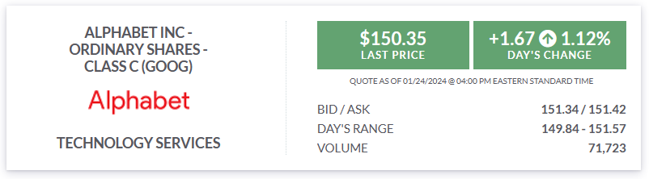
Stock Market Prices
Bid Price – the most a buyer is willing to pay for.
Ask Price – the least a seller is willing to sell for.
Last Prices - the price agreed upon the last time a buyer and seller agreed to trade.
Notes:
If a trader wants to buy a stock with a market order, they will pay the ask price, and if they want to sell with a market order, they will receive the bid price.

Slide 6
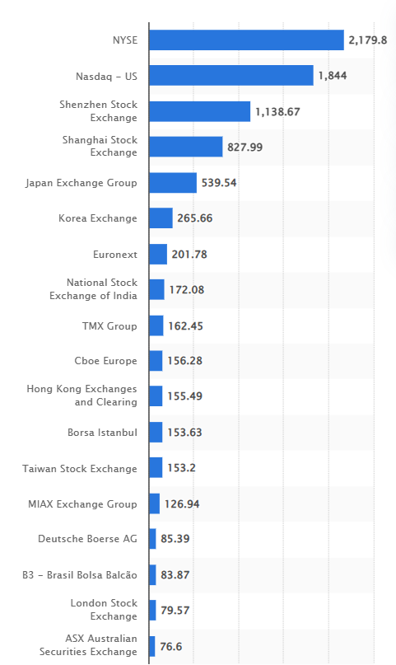
Stock Markets
The stock market operates on the fundamental economic principle of supply and demand.
Prices continuously adjust based on the balance of sellers (supply) and buyers (demand).
These movements are monitored and facilitated by stock exchanges, where investors transact to buy or sell shares.
Notes:
Graph: Largest stock exchange operators worldwide in September 2023, by value of electronic order book share trading (in billion U.S. dollars). Reference: Leading stock exchanges by value of traded shares 2023 | Statista

Slide 7
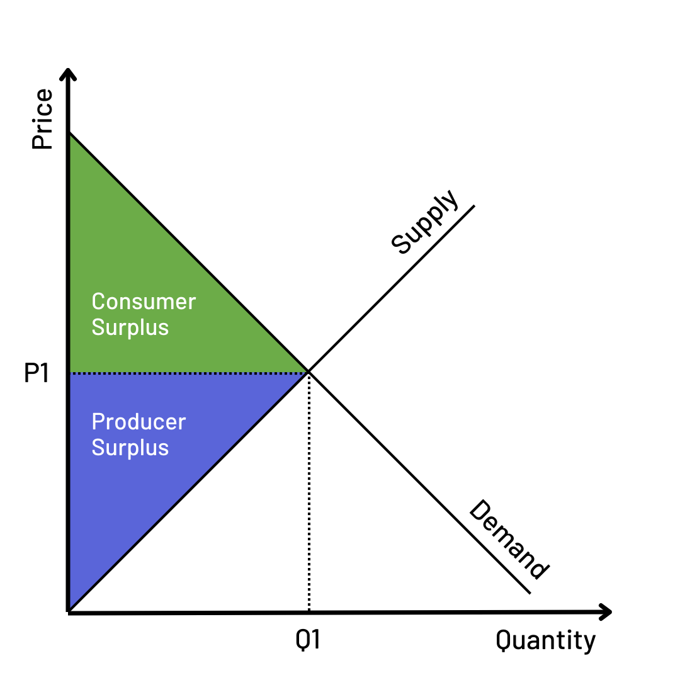
Efficient Equilibrium
Efficient equilibrium refers to a pricing and trading system that provides the maximum total surplus.
The stock exchange pairs the highest limit buys with the lowest limit sells to maximize the number of trades.
This maximizes the value for all current buyers and sellers on the market by setting the price the most people agree to.
Notes:
This is not always fair to every buyer and seller. The surpluses are explained on the following slide.

Slide 8
Surpluses
Consumer Surplus = Highest Price a buyer is willing to pay – Price they actually pay
Producer Surplus = Price a seller actually sells an item for – Lowest price they would sell for
Total Surplus = Consumer Surplus + Producer Surplus
Note: In a system where investors trade at one price, the total surplus is usually much greater than when investors trade at various prices.
Notes:
The concept of surplus is crucial when analyzing supply and demand scenarios in the stock market because it represents the additional benefit gained by consumers or producers in the trading process. It essentially measures the 'economic wellbeing' or 'gain' of consumers and producers in a market transaction.
Consumer Surplus = Highest Price a buyer is willing to pay – Price they actually pay
Producer Surplus = Price a seller actually sells an item for – Lowest price they would sell for
Total Surplus = Consumer Surplus + Producer Surplus
Note: In a system where investors trade at one price, the total surplus is usually much greater than when investors trade at various prices.

Slide 9
Discussion Questions
Describe in your own words Supply and Demand.
Notes:
Supply and demand are fundamental concepts in economics that depict the relationship between the availability of a particular product and the desire or need for that product by consumers.
Supply: the quantity of a product or service a seller (like a business or a manufacturer) is willing to provide at a certain price.
Factors influencing supply: production costs, pricing, technological advancements, competition, and governmental regulations.
When these factors result in high production, the supply increases. Conversely when these factors discourage production, supply decreases.
Demand: how much (quantity) of a product or service is desired or needed by buyers. The quantity demanded is the amount of a product people are willing to buy at a certain price.
Factors influencing demand: income, preference, expectations, price of related goods etc.
If consumers want or need a product a lot, the demand is high. If consumers don't want or need a product much, the demand is low.
The interaction between supply and demand establishes the market price; when demand is high and supply is low, prices tend to rise. Conversely, when supply is high and demand is low, prices tend to drop.
This is the basic principle of market economy and it largely determines how resources are allocated in capitalist societies.

Slide 10
Discussion Questions
How does the concept of market equilibrium help to determine the price and quantity at which trades occur in the stock market?
Notes:
Market equilibrium in the stock market is the point at which the quantity of shares that buyers are willing to buy matches the quantity that sellers are willing to sell at a specific price. It is a state of balance where the demand and supply of a stock coincide.
This concept plays a critical role in determining the price and quantity of trades in the stock market as follows:
Price Determination: When the demand for a particular stock is high, and supply is low, the price of the stock will increase until it reaches a point where the quantity supplied equals the quantity demanded - this is the equilibrium price. Conversely, if the supply of a stock exceeds demand, the price will drop until it hits the equilibrium point.
Quantity Determination: The quantity of shares traded in the stock market is also determined by the market equilibrium. At the equilibrium price, the quantity of stock that sellers wish to sell equals the quantity that buyers wish to buy. This equality represents the equilibrium quantity.
Market Efficiency: The concept of market equilibrium is central to market efficiency. Prices that stray away from the equilibrium level indicate either a surplus or a shortage, which triggers a response from buyers and sellers facilitating a return towards equilibrium. This constant pursuit of equilibrium ensures that resources are optimally allocated in the market.
Therefore, market equilibrium provides a critical reference point for buyers and sellers alike, guiding their decision-making process and contributing to overall market efficiency.

Slide 11
Discussion Questions
Why is it important to consider the concept of surplus when analyzing supply and demand examples in the stock market?
How does total surplus impact the efficiency of the market?
Notes:
Market Efficiency: A market is said to be efficient if total surplus is maximized. This means the market is allocating resources in a way that maximizes the total benefit to society. When a market is efficient, there's no way to make some people better off without making others worse off.
Price Evaluation: The concept of surplus helps evaluate whether the market price of a stock is 'fair.' If the consumer and producer surplus are equal, it suggests a 'fair' market price where both buyers and sellers are equally benefiting.
Analysis of Market Changes: Surplus analysis can help determine how changes in supply or demand conditions will affect the welfare of producers and consumers.

Slide 12
Key Takeaways
Market equilibrium is the point where supply equals demand, and it is the price and quantity at which trades occur.
Efficient equilibrium occurs when the total surplus, which is the sum of consumer surplus and producer surplus, is maximized.
In a trading system where every trade has a different price, the total surplus is lower compared to a system where all trades occur at the same price.
The stock market functions like a system of limit orders, where sellers set limit sell orders and buyers set limit buy orders.
Notes:
Market equilibrium is the point where supply equals demand, and it is the price and quantity at which trades occur.
Efficient equilibrium occurs when the total surplus, which is the sum of consumer surplus and producer surplus, is maximized.
In a trading system where every trade has a different price, the total surplus is lower compared to a system where all trades occur at the same price.
The stock market functions like a system of limit orders, where sellers set limit sell orders and buyers set limit buy orders.

