Slide 1

Understanding Price Movements
Stocks & Bonds
Copyright Stock-Trak, Inc. 2023-2024

Slide 2
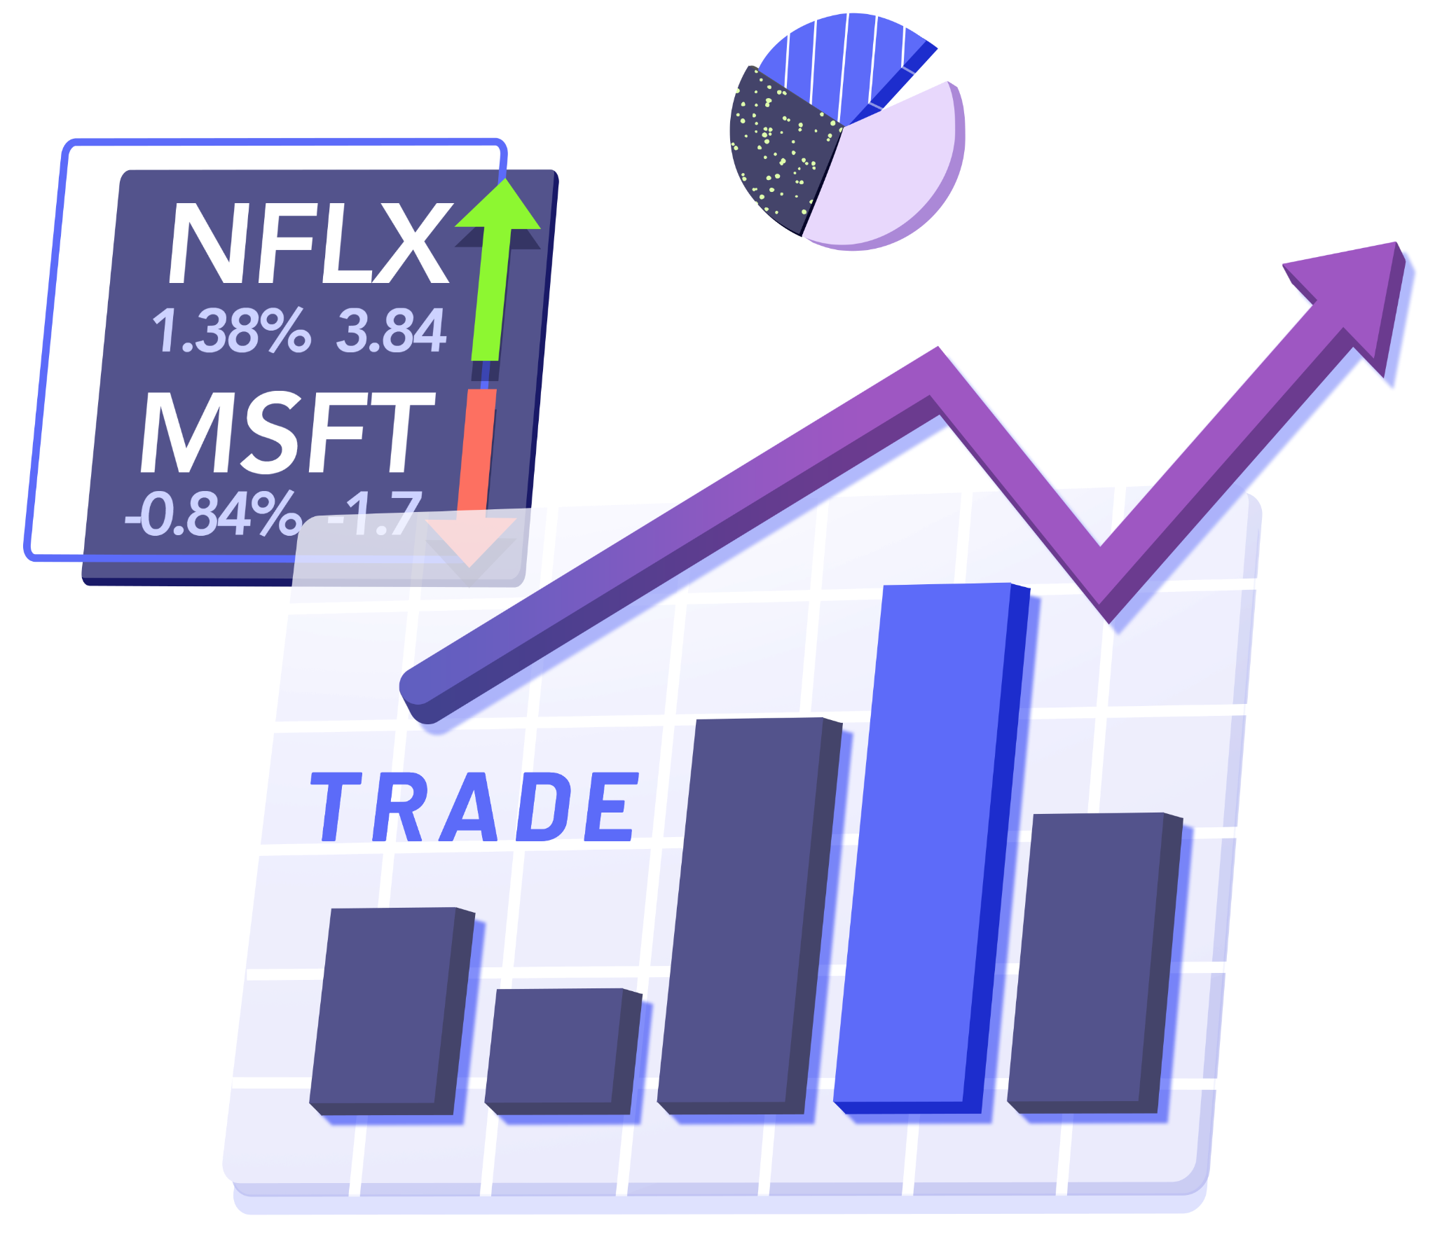
Stock Prices
Stock prices reflect the present value of future earnings expectations.
Positive expectations can drive stock prices higher.
Negative expectations can lead to price declines.
Stock prices are influenced by financial performance, market trends, economic conditions, and investor sentiment.
Notes:
Stock prices reflect the present value of future earnings expectations.
Positive expectations can drive stock prices higher.
Negative expectations can lead to price declines.
Stock prices influenced by financial performance, market trends, economic conditions, and investor sentiment.

Slide 3
Financial Performance
Investors analyze a company’s current and projected financial performance through various methods and tools:
Financial Statements - income statements, balance sheets, and cash flow statements.
Financial Ratios & Key Performance Indicators (KPIs) - profitability, liquidity and solvency ratios, revenue growth rate, return on investment (ROI), return on equity (ROE) and market share.
Earnings Reports - quarterly and annual reports announce a company’s most recent historical performance.
Notes:
Investors analyze a company’s current and projected financial performance through various methods and tools:
Financial Statements - income statements, balance sheets, and cash flow statements.
Financial Ratios & Key Performance Indicators (KPIs) - profitability, liquidity and solvency ratios, revenue growth rate, return on investment (ROI), return on equity (ROE) and market share.
Earnings Reports - quarterly and annual reports announce a company’s most recent historical performance.

Slide 4
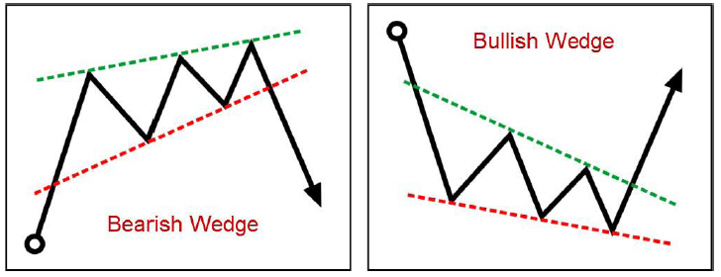
Market Trends
Definition: the observable direction a market is moving over a specific period.
Positive market trends may increase investor optimism and drive stock prices higher.
Negative trends can create downward pressure on stock prices.
Notes:
Positive market trends may increase investor optimism and drive stock prices higher. For Example: the technology sector is increasing due to high investor confidence and strong financial performance.
Negative trends can create downward pressure on stock prices. For Example: the automobile sector is declining due to poor sales figures and low consumer demand.
Image reference: How to Learn Forex Chart Patterns|Chart Pattern Trading Strategy Step-by-Step Guide –Forex Trading Strategy|Wedge|Head and Shoulders|Double Tops/Bottoms ~ Forex Expert Knowledge

Slide 5
Economic Conditions
Definition: refers to the state of the economy at any given time
Key Indicators: GDP growth rate, unemployment rate, inflation rate, and interest rates.
Strong Economy: high GDP growth rate, low unemployment, low inflation, and stable interest rates.
Weak Economy: negative GDP growth, high unemployment, high inflation, and fluctuating interest rates.
Notes:
Economic conditions refer to the state of the economy at any given time
Key Indicators: GDP growth rate, unemployment rate, inflation rate, and interest rates.
Strong Economy: high GDP growth rate, low unemployment, low inflation, and stable interest rates.
Weak Economy: negative GDP growth, high unemployment, high inflation, and fluctuating interest rates.

Slide 6
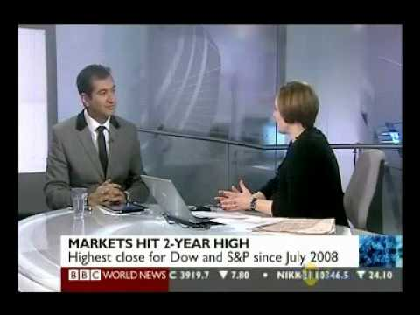
Investor Sentiment
Definition: refers to the overall investor attitude or mood. Influences investment decisions and market trends.
Positive Investor Sentiment: Triggered by strong economic indicators or positive corporate news, leading to increased buying activity.
Negative Investor Sentiment: Caused by poor economic news or disappointing earnings reports, resulting in increased selling and lower prices.
Notes:
Investor sentiment refers to overall investor attitude or mood. Influences investment decisions and market trends.
Positive Investor Sentiment: Triggered by strong economic indicators or positive corporate news, leading to increased buying activity.
Negative Investor Sentiment: Caused by poor economic news or disappointing earnings reports, resulting in increased selling and lower prices.
Check out: Chart: 30 Years of Investor Sentiment (visualcapitalist.com)
Image Reference: Positive investor sentiment for 2011 (youtube.com)

Slide 7
Expected vs Realized Earnings
Realized Earnings refer to a company’s actual earnings for a given period.
Expected Earnings are what investors predict the company will earn in the future.
Notes:
Realized Earnings refer to a company’s actual earnings for a given period.
Expected Earnings are what investors predict the company will earn in the future.

Slide 8
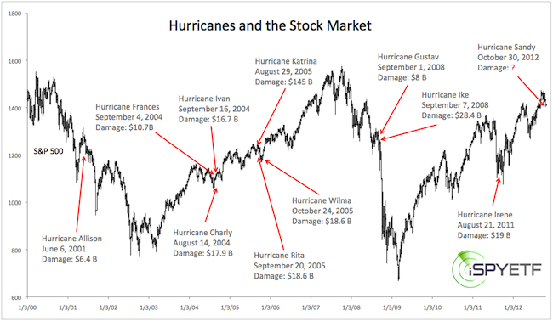
Systematic vs Unsystematic Risk
Systematic Risk
Events that can affect the stock market as a whole.
For Example: wars, interest rate fluctuations, recessions and geopolitical events
Unsystematic Risk
Specific to the company or industry.
For Example: companies that sell fresh produce are affected by droughts or hurricanes
Notes:
Systematic Risk refers to events that can affect the stock market as a whole.
For Example: wars, interest rate fluctuations, recessions and geopolitical events
Unsystematic Risk is specific to the company or industry.
For Example: companies that sell fresh produce are affected by droughts or hurricanes
Image Reference: How Will Hurricane Sandy Affect Stocks and the U.S. Economy? « iSpyETF (wordpress.com)

Slide 9
What is an IPO?
Definition: An Initial Public Offering (IPO) is the process where a private company offers its shares to the public for the first time to raise capital, becoming a publicly traded and owned entity.
Investment banks, such as Goldman Sachs Group Inc. (GS), JP Morgan Chase & Co. (JPM), or UBS Group AG Registered (UBS), play a vital role in the IPO process.
Notes:
An Initial Public Offering (IPO) is the process where a private company offers its shares to the public for the first time to raise capital, becoming a publicly traded and owned entity.
Investment banks, such as Goldman Sachs Group Inc. (GS), JP Morgan Chase & Co. (JPM), or UBS Group AG Registered (UBS), play a vital role in the IPO process.

Slide 10
IPO Process
1. Discussion of IPO pitch with investment bankers.
2. Selection of book runners and co-managers to handle the sale of newly issued stocks.
3. Filing of necessary registration forms; discuss timing of IPO.
Notes:
1. Discussion of IPO pitch with investment bankers.
2. Selection of book runners and co-managers to handle the sale of newly issued stocks.
3. Filing of necessary registration forms; discuss timing of IPO.

Slide 11
IPO Process
4. Due diligence conducted by bankers, which includes customer interviews, industry research, analysis of legal situation, and scrutiny of financial statements.
5. Filing of the S-1 form, releasing historical financial statements, key data, and other investor-relevant information.
6. Pre-marketing stage where bankers converse with investors to determine a price range for the initial stock offering.
Notes:
4. Due diligence conducted by bankers, which includes customer interviews, industry research, analysis of legal situation, and scrutiny of financial statements.
5. Filing of the S-1 form, releasing historical financial statements, key data, and other investor-relevant information.
6. Pre-marketing stage where bankers converse with investors to determine a price range for the initial stock offering.

Slide 12
IPO Process
7. Final price determination after further conversations with investors.
8. Shares are allocated to investors before the first day of trading.
9. Opening trade for investors and the general public.
Notes:
7. Final price determination after further conversations with investors.
8. Shares allocation to investors before the first day of trading.
9. Opening trade for investors and the general public.

Slide 13
IPO Process
10. Post-IPO period often characterized by high stock volatility due to investor sentiment.
11. Assessment of investor sentiment, with bearish investors anticipating a market decline and bullish investors anticipating market growth, often influenced by company earnings.
Notes:
10. Post-IPO period often characterized by high stock volatility due to investor sentiment.
11. Assessment of investor sentiment, with bearish investors anticipating a market decline and bullish investors anticipating market growth, often influenced by company earnings.

Slide 14
Bonds
Bonds are fixed-income securities that represent loans made by investors to borrowers such as corporations or governments. They're primarily used to finance projects.
For example: government bonds, corporate bonds, savings bonds or junk bonds.
Notes:
Government Bonds: These are issued by national governments, and are often considered low-risk as they come backed by the full faith and credit of the government. An example is the U.S. Treasury bond.
Corporate Bonds: These are issued by companies to raise capital for business operations or expansions. For instance, Apple Inc. might issue a bond to fund research and development efforts.
Municipal Bonds: These are issued by local governments or entities like cities, counties, or school districts to finance public projects. For instance, a city might issue a bond to fund the construction of a new school.
Savings Bonds: These are often issued by the government as a savings tool for individuals. They have a low return rate but are very safe. An example is U.S. Savings bonds.
Junk Bonds: These bonds are high-risk, high-yield bonds issued by organizations with poor credit ratings. They offer high returns due to their high likelihood of default.

Slide 15

The Principal
The principal refers to the amount of money that the investor initially lends to the bond issuer.

Slide 16

The Coupon Rate
The coupon rate is the annual interest rate paid on a bond, expressed as a percentage of the principal.

Slide 17

The Maturity Date
The maturity date is the specified date on which the bond issuer will repay the principal to the bondholder.

Slide 18
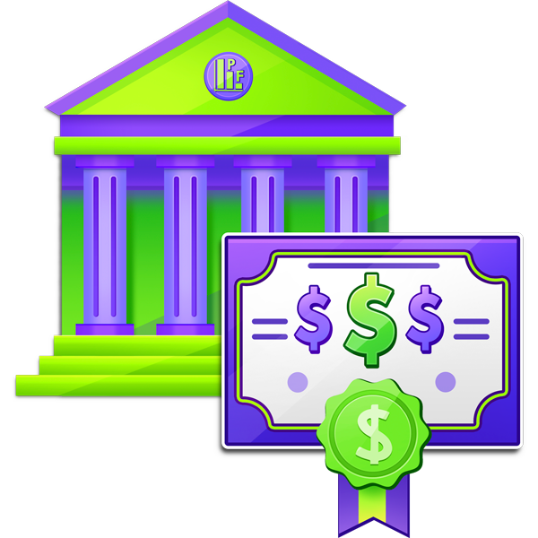
The Yield
The yield refers to the rate of return earned on a bond if it is held until its maturity date, taking into account both the interest payments received periodically and any capital gain or loss at maturity.

Slide 19
Mechanics of Bonds
A bondholder lends money (principal) to a borrower, who, in exchange, agrees to pay a predetermined level of interest (coupon) over a fixed period, and repay the principal at the bond's maturity date.
Investors can sell a bond before its maturity date making it a flexible investment tool.

Slide 20
Bond Prices
Interest Rate Risk: Prices move inversely with interest rates; as rates increase, bond prices decrease and vice versa.
Inflation: Higher inflation degrades the real value of periodic coupon payments.
Credit Ratings: Higher ratings suggest lower risk, leading to lower interest rates and higher bond prices. Reiterate that as credit ratings increase, so does the bond price.
Notes:
Bond prices experience fluctuations due to interest rate risk, inflation, and credit ratings assigned by rating agencies.
Interest rates and bond prices have an inverse relationship, as rates rise, bond prices fall, and vice versa.
Inflation also affects bond prices, as higher inflation decreases the value of the coupon payments and lowers the effective yield.
Credit ratings assigned by rating agencies can significantly influence bond prices, with higher ratings leading to lower interest rates and vice versa.

Slide 21
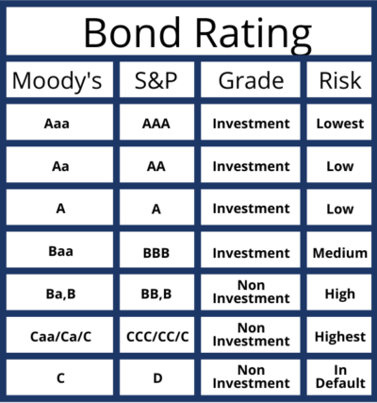
Credit Ratings
Definition: assessments by ratings agencies (like S&P, Moody's, Fitch) of the creditworthiness of a borrower, either a corporation or a government.
Notes:
They indicate the risk level of the borrower's ability to repay loans and influence interest rates on debt.
Image reference: Understanding Tenant Credit Ratings in a Triple Net Lease (aipcommercialrealestate.com)

Slide 22
Discussion Questions
How do positive and negative expectations impact stock prices?
Notes:
When investors have positive expectations for a company - such as strong financial reports, innovative product releases, or expansion into new markets - demand for the company's stocks tends to increase. As demand goes up, so do stock prices, reflecting the perceived value of the company.
When investors have negative expectations - such as disappointing earnings, poor management, or critical operational failures - prevail, investors may lose confidence in the company. As a result, demand for the company's stocks decreases: investors sell off their shares, leading to a drop in stock prices.
These expectations can be based on a multitude of factors, including speculation, market sentiment, economic indicators, and geopolitical events.

Slide 23
Discussion Questions
What are the differences between realized and expected earnings?
How can these affect investment decisions?
Notes:
Realized earnings refer to the actual profits a company has made, typically disclosed in quarterly and annual financial statements. These are official numbers that show how a company has performed in the past.
Expected earnings are projections or estimates about how much profit a company will make in the future. These forecasts can be made by the company's management, industry analysts, or investors themselves based on various factors such as previous earnings, current market conditions, and future plans of the company.
Investment decisions can be significantly influenced by both realized and expected earnings:
1. Realized Earnings: If a company consistently posts strong realized earnings, it can generate confidence among investors, potentially leading to greater demand for the company's stocks and an increase in its stock price. Conversely, weak or declining realized earnings could reduce investor confidence and demand, leading to a decrease in stock price.
2. Expected Earnings: Positive expected earnings can generate investor excitement and increase stock prices as investors anticipate future growth. If expected earnings are not met, however, stock prices can fall as investors recalibrate their valuations. Therefore, forecasts need to be realistic and align closely with eventual realized earnings to maintain investor trust.

Slide 24
Discussion Questions
Can you give an example of a systemic and an unsystematic risk?
How can these types of risks impact a company's stock performance?
Notes:
Systemic Risk: This is a risk that affects the entire market or a broad segment of the market. An example would be the 2008 financial crisis, which negatively impacted vast swathes of the global economy. A systemic event like this can cause a company's stock to plummet, even if the company's fundamentals remain strong.
Unsystematic Risk: This is a risk that is specific to a particular company or industry. For example, if a pharmaceutical company's key drug does not receive FDA approval, the company's stock price can decrease rapidly. Similarly, a scandal involving a company's CEO may lead to a drop in the company's stock price. This risk is specific to the company and does not affect the broader market.
Investors can manage these risks through diversification.
By investing in a variety of stocks across industries, they can mitigate unsystematic risk—the risk inherent within one company or industry. Systemic risk, however, cannot be avoided through diversification because it impacts the entire market. Instead, investors might consider different asset classes (like bonds or real estate) or safe-haven investments during periods of high systemic risk.

Slide 25
Discussion Questions
How can an investor use financial statements and other financial indicators to analyze a company's performance?
Notes:
Investors utilize financial statements and various financial indicators to evaluate a company's performance, financial health, and future prospects.
Income Statement: Shows the company's revenues, costs, and profits. Investors look at trends in revenues and profit margins, as consistent growth can be a positive sign while declining margins may suggest problems.
Balance Sheet: Provides a snapshot of a company's assets, liabilities, and shareholders' equity. Investors may analyze ratios such as the debt-to-equity ratio for insights into the company's capital structure and financial stability.
Cash Flow Statement: Shows how much cash a company generates and uses during a period. Investors often focus on free cash flow, which is cash flow from operations minus capital expenditures. This indicates a company's ability to fund growth, pay dividends, or reduce debt.
Key Financial Indicators: These can include earnings per share (EPS), price-to-earnings (P/E) ratio, return on equity (ROE), and others. These metrics allow investors to compare performance across companies and industries.
Management Discussion & Analysis (MD&A): Included in the annual report, MD&A often provides insights into company strategy, market conditions, and future plans. It can give investors an understanding of management's perspective and confidence.
6. Economic Indicators: Broader economic trends can also impact a company's performance. Examples include GDP growth, employment data, interest rates, and inflation.

Slide 26
Discussion Questions
What role do credit ratings play in determining interest rates on debt and why is this important for companies and governments?
Notes:
A high credit rating suggests that the issuer has a low risk of defaulting on the debt, and thus they are rewarded with lower interest rates. This is because lenders believe there’s a strong chance they’ll be repaid and therefore require less compensation (in the form of interest) for the risk they’re taking.
A low credit rating signals a higher risk of default. So, to compensate for the increased risk, these issuers must pay higher yields (interest rates) on their debt to attract investors.
For Companies: The cost of borrowing affects profitability. High interest rates mean higher borrowing costs, reducing net income, which potentially lowers the stock price.
For Governments: Servicing high-interest debt can drain resources and lead to budgetary constraints. A high credit rating can save governments billions in interest over the long term, allowing more funds for public services, capital improvements, and reducing the debt burden.

Slide 27
Key Takeaways
Stock prices mirror the present value of future earnings expectations.
They are influenced by financial performance, economic conditions, market trends, and investor sentiment.
Investment banks play a key role in the IPO process, assisting companies in pricing their offerings and meeting regulatory requirements.
Earnings reports, including expected and realized earnings, can greatly impact stock prices.
Systematic risk affects the stock market, while unsystematic risk is specific to a company or industry.
Bond prices are affected by interest rate risk and inflation.
Credit ratings assigned by rating agencies can influence bond prices and interest rates.
Notes:
Stock prices mirror the present value of future earnings expectations.
They are influenced by financial performance, economic conditions, market trends, and investor sentiment.
Investment banks play a key role in the IPO process, assisting companies in pricing their offerings and meeting regulatory requirements.
Earnings reports, including expected and realized earnings, can greatly impact stock prices.
Systematic risk affects the stock market as a whole, while unsystematic risk is specific to a company or industry.
Bond prices are affected by interest rate risk and inflation.
Credit ratings assigned by rating agencies can influence bond prices and interest rates.

