Slide 1

What is the Federal Reserve?
Part 1 - Objectives & Functions
Copyright Stock-Trak, Inc. 2023-2024
Notes:
This presentation is best followed by the Monetary Policy presentation.

Slide 2
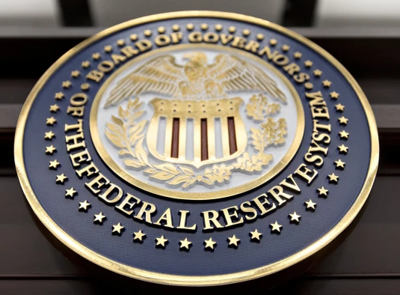
What is the Federal Reserve?
The central banking system of the United States.
Regulates the US dollar.
Acts as the "lender of last resort" for other banks.
Notes:
Image Reference: Bloomberg, Lessons from the credit crunch (ft.com)
The organization responsible for conducting monetary policy and ensuring that a nation’s financial system operates smoothly is called the central bank. Most nations have central banks or currency boards. Some prominent central banks around the world include the European Central Bank, the Bank of Japan, and the Bank of England. In the United States, the central bank is called the Federal Reserve—often abbreviated as “the Fed.”
An excerpt from: The Federal Reserve System | Introduction to Business (lumenlearning.com)
"Lender of last resort" refers to a central bank's role in providing emergency liquidity assistance to financial institutions or banks that are facing severe financial difficulties and may not be able to obtain funds from other sources.
The relationship with commercial banks:
Banks are required to have a reserve requirement.
Banks can deposit reserves at the Federal Reserve.
The Fed acts as the "lender of last resort" for banks in need of loans.

Slide 3
Objectives
The Federal Reserve has 2 primary objectives:
To encourage full employment (make the economy grow).
To discourage inflation.
Balancing these objectives is crucial for maintaining a stable economy.
Notes:
These two goals are directly opposed to each other (one says lower interest rates, one says raise interest rates).
By actively managing monetary policy, including setting interest rates, the Federal Reserve aims to achieve an optimal balance between maintaining full employment and stable inflation. It uses various tools to influence economic conditions while considering the potential trade-offs between these objectives. This balancing act is crucial in fostering a healthy and stable economy.

Slide 4
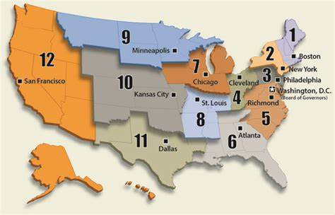
The Federal Reserve System
Divided into 12 branches.
Each branch is responsible for a specific territory.
The New York ‘Fed’ leads the Federal Open Market Committee.
Notes:
Divided into 12 branches: Atlanta, Boston, Chicago, Cleveland, Dallas, Kansas City, Minneapolis, New York, Philadelphia, Richmond, San Francisco, St. Louis.
Federal Reserve Banks: serve as the operational arms of the Federal Reserve, implementing monetary policy, supervising banks, and providing a range of financial services to depository institutions within their regions.

Slide 5
Federal Open Market Committee
Federal Open Market Committee (FOMC) is when the leaders of the Fed meet to discuss monetary policy (namely interest rates). There are 12 members:
  7 members of the Board of Governors
  5 of the regional Federal Reserve Bank presidents.
Responsible for monetary policy decisions: setting interest rates & buying/selling government securities on the open market.
Notes:
The Federal Open Market Committee (FOMC) is a branch of the Federal Reserve System in the United States.
It consists of the seven members of the Board of Governors and five of the twelve regional Federal Reserve Bank presidents.
The committee is responsible for making decisions on monetary policy, including setting interest rates and making decisions on the purchasing and selling of government securities in the open market.
The FOMC determines the interest rate at which banks can borrow from the Federal Reserve, which in turn impacts the interest rates banks offer their customers.

Slide 6
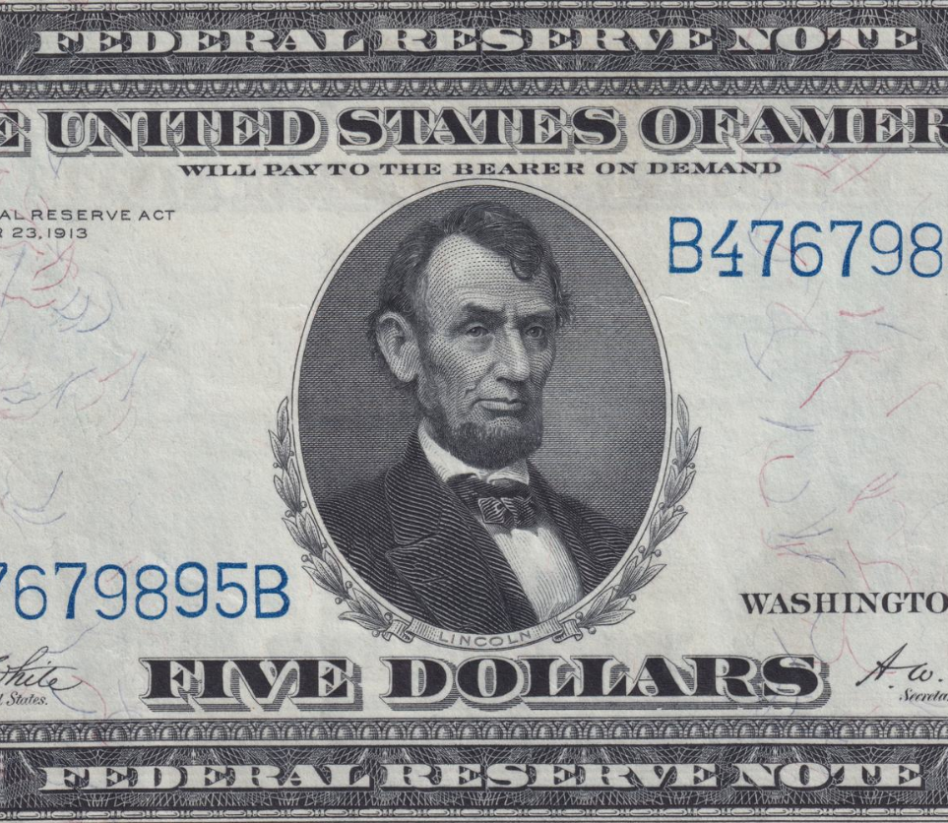
Functions of the Federal Reserve
Keep Inflation Low
Promote Economic Growth
Notes:
Research, setting monetary policy, regulating the currency are all just things they do to achieve those goals.
Monetary Policy Control: The Federal Reserve sets the federal funds rate, which is the benchmark interest rate that banks charge each other for short-term loans. This rate indirectly affects interest rates on various loans, such as mortgages and auto loans, and can influence borrowing costs for consumers and businesses.
Regulates Currency: The Federal Reserve controls the money supply through its ability to influence the lending and deposit activities of banks. It uses reserve requirements, which are regulations specifying the minimum amount of reserves banks must hold against their deposits. This allows the Federal Reserve to maintain stability and control over the money supply. The Federal Reserve regulates currency, all dollars have "federal reserve note" written on them. They are not issued by the treasury - they are issued by the Federal Reserve.
Economic Influence: The Federal Reserve plays a key role in influencing economic growth and managing inflation. Its monetary policy decisions can impact consumer spending, business investment, and employment levels. By adjusting interest rates, the Federal Reserve can stimulate or cool down economic activity in an attempt to maintain price stability and promote sustainable growth.
Research: The Federal Reserve is the biggest economic research organization. Investigating economic development and the effects of new currencies. Providing economic data such as the Gross Domestic Product (GDP).

Slide 7
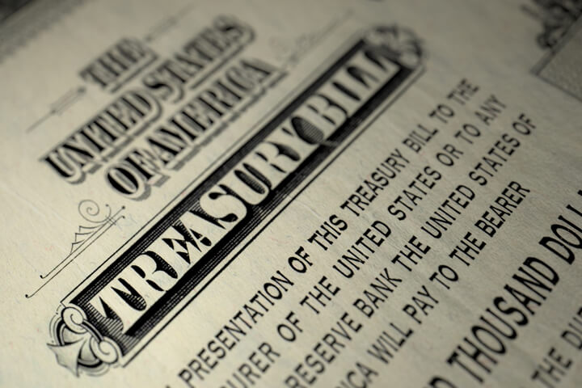
Operates Independently
To shield monetary policy decisions from short-term political pressures.
To make decisions based on economic data and long-term goals.
Accountable to the public & Congress.
Notes:
The Federal Reserve operates independently from the political branches of the government. It is accountable to the public and the Congress. The Fed generates its own revenue by investing in government securities*, and any profits it gains beyond its operational costs are handed over to the Treasury.
This independence is intentional, aiming to shield monetary policy decisions from short-term political pressures. It allows the Federal Reserve to make decisions based on economic data and long-term goals rather than immediate political considerations.
*Government securities refer to financial instruments or bonds issued by the government to finance its operations and meet funding needs. These securities are typically considered low-risk investments because they are backed by the credit of the government, and they offer a fixed rate of interest over a specific period. Government securities can include treasury bills, treasury notes, treasury bonds, and inflation-protected securities (TIPS). They are traded in the open market and are often purchased by investors, financial institutions, and central banks as a safe investment option.

Slide 8
Discussion Questions
How does the Federal Reserve regulate the economy through its control of interest rates?
Notes:
Today, most new money isn't printed bills, it is digital money. This is based on banks borrowing money from the Federal Reserve. Banks must pay the Fed back through the interest they earn on the loans they issue. The Federal Reserve sets the federal funds rate, which is the benchmark interest rate that banks charge each other for short-term loans. This rate indirectly affects interest rates on various loans, such as mortgages and auto loans, and can influence borrowing costs for consumers and businesses.
Low interest rates encourage borrowing and economic growth.
High interest rates discourage borrowing and slow down the economy.
The Fed adjusts rates to stimulate or slow down the economy.

Slide 9
Discussion Questions
Provide examples of how changes in interest rates might affect businesses and individuals?
Notes:
The Federal Reserve adjusts interest rates for one of the following reasons:
To fight inflation - raising interest rates discourages borrowing, which means companies aren't borrowing money to finance growth that they need to pay back. If they aren't borrowing, they aren't spending, so other companies can't keep raising prices.
To discourage risky investing - if it looks like too many people are borrowing money cheaply, they take bigger risks. Higher interest rates means they need to think harder about how they will pay back the loan.
If the economy is looking like a recession is coming, the Fed will want to lower interest rates to encourage borrowing and economic growth. If interest rates are already near zero, they can't do that - so they lose that "lever".

Slide 10
Discussion Questions
Why is it important for the Federal Reserve to maintain a stable inflation rate?
Notes:
Maintaining a stable inflation rate is important for several reasons. First, stable inflation promotes price stability, allowing consumers and businesses to plan and make economic decisions with confidence. When inflation is low and predictable, it reduces uncertainty and facilitates long-term planning.
Stable inflation supports sustainable economic growth. If inflation is too high, it erodes the purchasing power of money, leading to reduced consumer spending and investment. On the other hand, if inflation is too low or negative (deflation), it can discourage spending and investment as consumers and businesses anticipate further price declines.

Slide 11
Discussion Questions
What role does the Federal Reserve play in regulating the banking system?
How does its function as the "lender of last resort" contribute to the stability of the banking industry?
Notes:
The Federal Open Market Committee (FOMC) determines the interest rate at which banks can borrow from the Federal Reserve, which in turn impacts the interest rates banks offer their customers.
"Lender of last resort" refers to a central bank's role in providing emergency liquidity assistance to financial institutions or banks that are facing severe financial difficulties and may not be able to obtain funds from other sources.
When financial institutions experience a liquidity shortage or are facing a potential collapse, the lender of last resort steps in to provide financial support, typically in the form of short-term loans or credits. This assistance helps ensure the stability and functioning of the financial system, as it prevents the risk of widespread bank failures or systemic disruptions.
The Federal Reserve acts as the lender of last resort to maintain confidence and stability in the economy during times of financial stress.
Fractional Reserve Banking System: The Federal Reserve controls the money supply through its ability to influence the lending and deposit activities of banks. It uses reserve requirements, which are regulations specifying the minimum amount of reserves banks must hold against their deposits. This allows the Federal Reserve to maintain stability and control over the money supply.

Slide 12
Key Takeaways
The Federal Reserve Bank serves as the central banking system of the United States.
Responsible for regulating the US dollar and maintaining its stability.
Controls interest rates to influence the money supply, economic growth, and inflation.
Acts as a lender of last resort for other banks, providing overnight loans to ensure liquidity.
Conducts extensive economic research, analyzing various aspects of the economy and monetary policy.
The Fed is divided into 12 branches, serving different territories across the United States.
Notes:
The Federal Reserve Bank serves as the central banking system of the United States.
Responsible for regulating the US dollar and maintaining its stability.
Controls interest rates to influence the money supply, economic growth, and inflation.
Acts as a lender of last resort for other banks, providing overnight loans to ensure liquidity.
Conducts extensive economic research, analyzing various aspects of the economy and monetary policy.
The Fed is divided into 12 branches, serving different territories across the United States.

